Slide 1
Simple Load Pull Report
None

Slide 2
Test Configuration
Frequencies: (GHz)
8.9, 9.4, 9.9, 10.4, 10.9, 11.4, 11.9
Input Powers: (dBm)
14, 16, 18, 22
Load Impedances:
Gamma Magnitude:
0.1, 0.2, 0.3, 0.4, 0.5
Gamma Phase
-175, -165, -155, -145, -135, -125, -115, -105, -95, -85, -75, -65, -55, -45, -35, -25, -15, -5, 5, 15, 25, 35, 45, 55, 65, 75, 85, 95, 105, 115, 125, 135, 145, 155, 165, 175
Comments
None
Data and Time: 2025-08-11_10_30

Slide 3
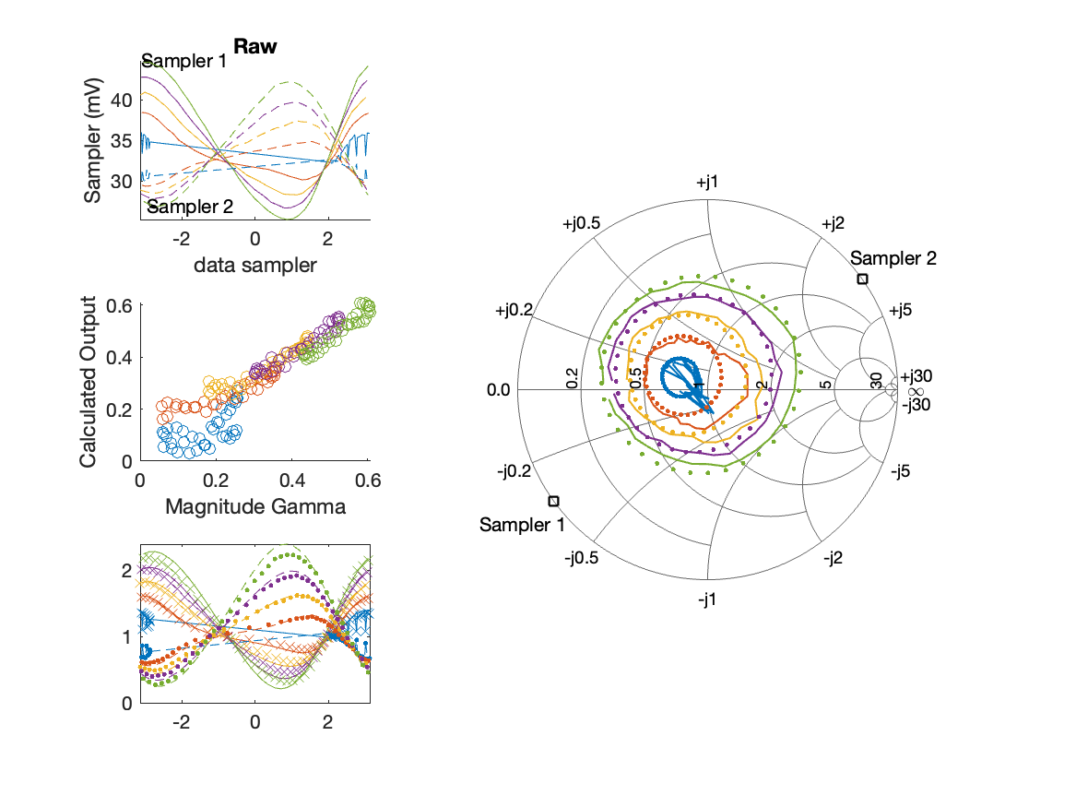
Sampler Performance Frequency 10.40 GHz, Power 14 dBm
Sampler Av
Sampler 1: 47.832
Sampler 2: 63.344
Sampler Offset (rather than -1)
-3.6033
Goodness Of fit
0.11418

Slide 4
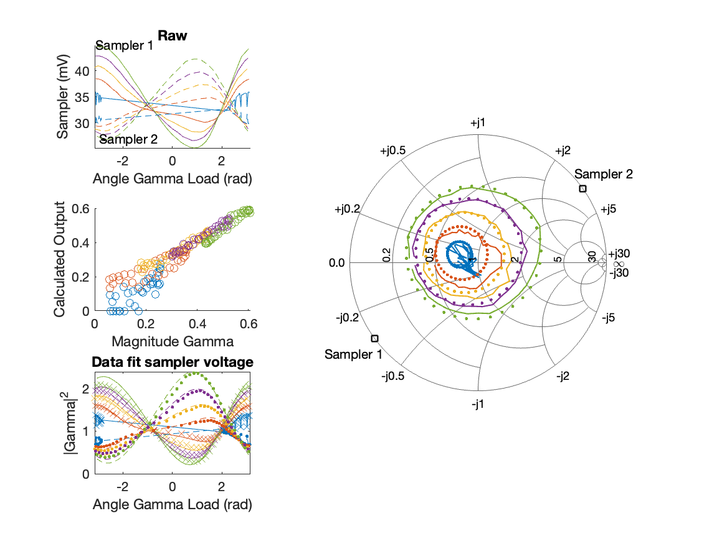
Sampler Performance x^3 Frequency 10.40 GHz, Power 14 dBm
Sampler Av
Sampler 1: 6.291566e+01
Sampler 2: 15.404
Sampler Av3
Sampler 1: -16.424
Sampler 2: 23.707
Sampler Offset (rather than -1)
-2.8469
Goodness Of fit
0.08084

Slide 5
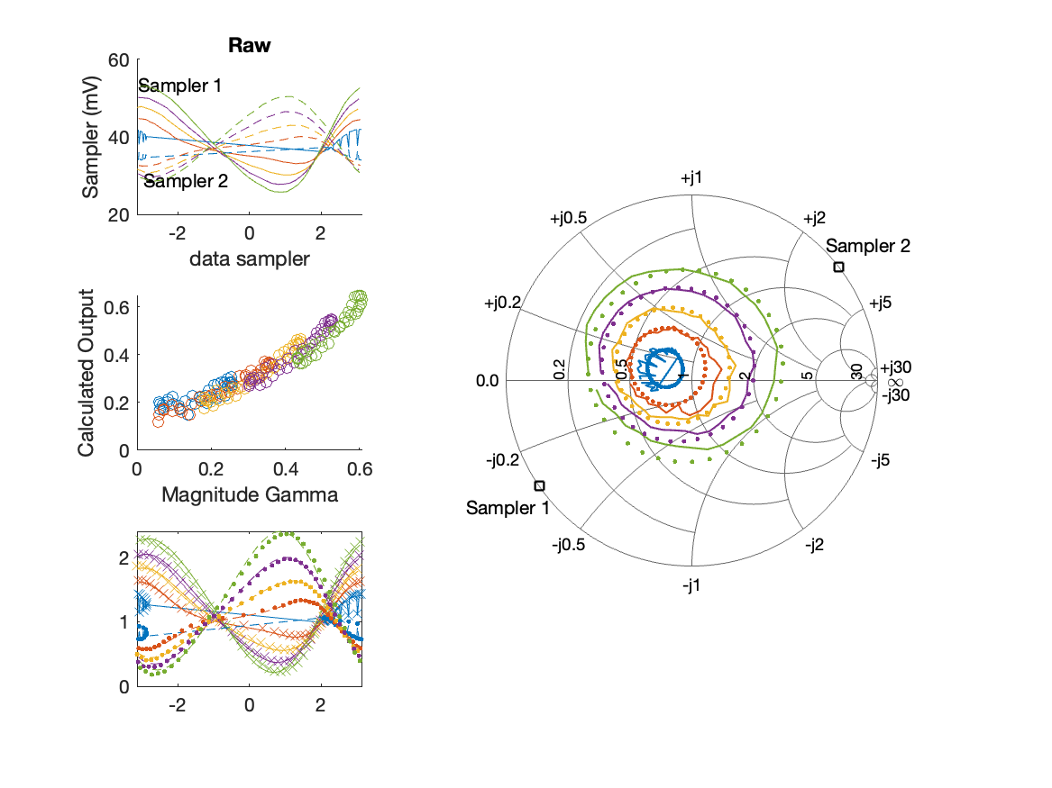
Sampler Performance Frequency 10.40 GHz, Power 16 dBm
Sampler Av
Sampler 1: 37.231
Sampler 2: 49.798
Sampler Offset (rather than -1)
-3.1788
Goodness Of fit
0.12167

Slide 6
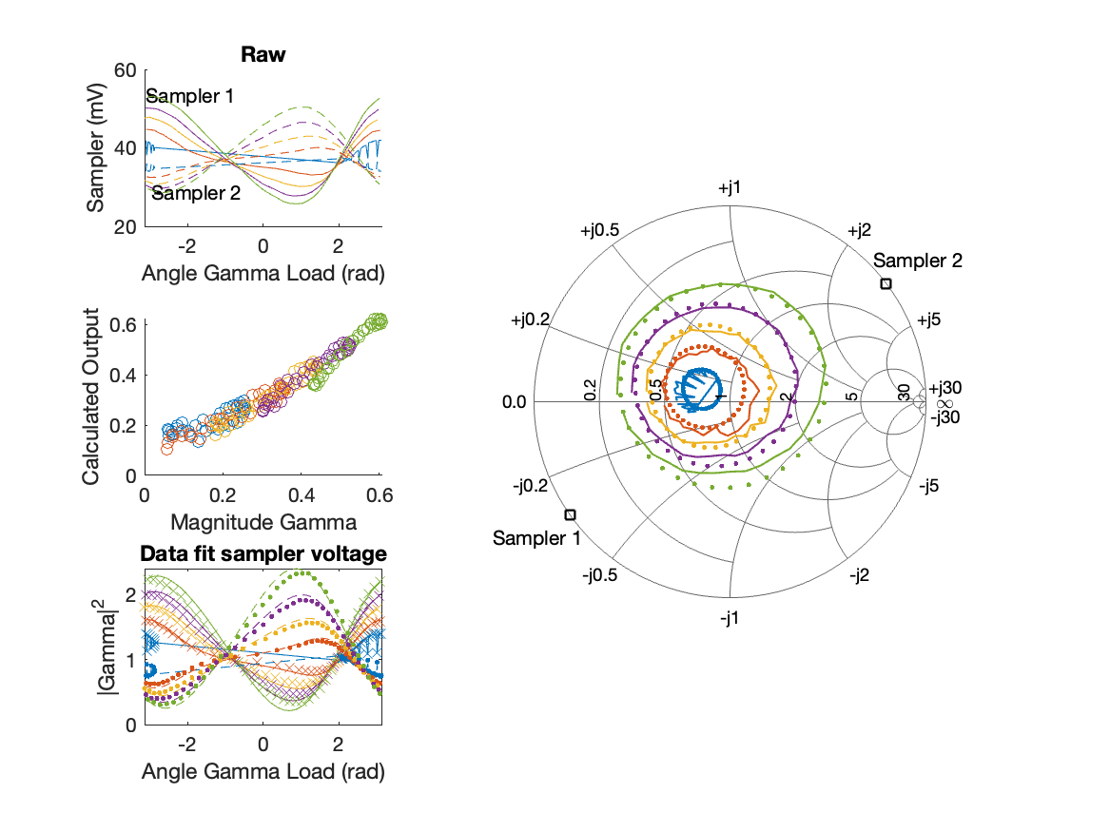
Sampler Performance x^3 Frequency 10.40 GHz, Power 16 dBm
Sampler Av
Sampler 1: 2.741796e+01
Sampler 2: 31.919
Sampler Av3
Sampler 1: 11.207
Sampler 2: 14.387
Sampler Offset (rather than -1)
-2.3828
Goodness Of fit
0.074013

Slide 7
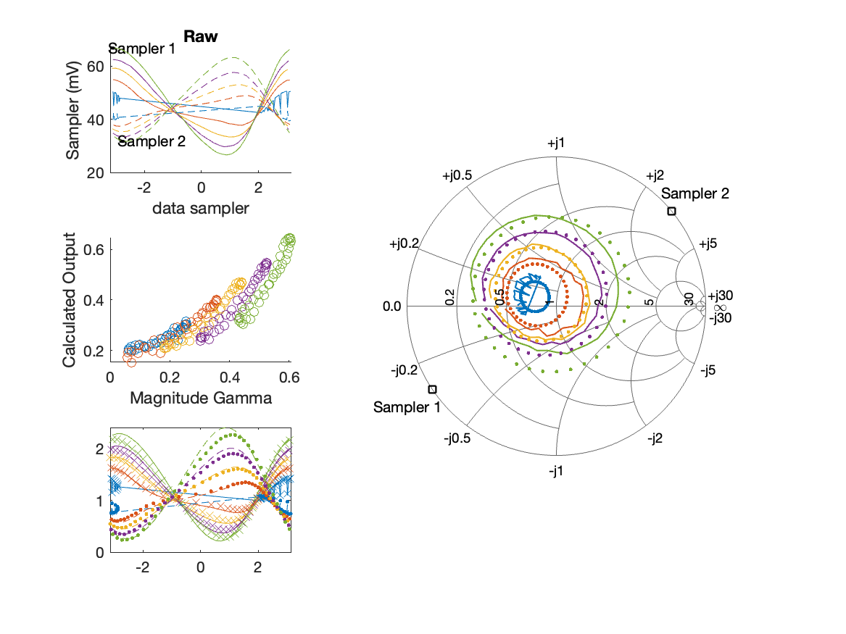
Sampler Performance Frequency 10.40 GHz, Power 18 dBm
Sampler Av
Sampler 1: 23.584
Sampler 2: 32.152
Sampler Offset (rather than -1)
-2.3929
Goodness Of fit
0.27474

Slide 8

Sampler Performance x^3 Frequency 10.40 GHz, Power 18 dBm
Sampler Av
Sampler 1: 1.499945e+01
Sampler 2: 15.598
Sampler Av3
Sampler 1: 9.541
Sampler 2: 12.440
Sampler Offset (rather than -1)
-1.5393
Goodness Of fit
0.14726

Slide 9
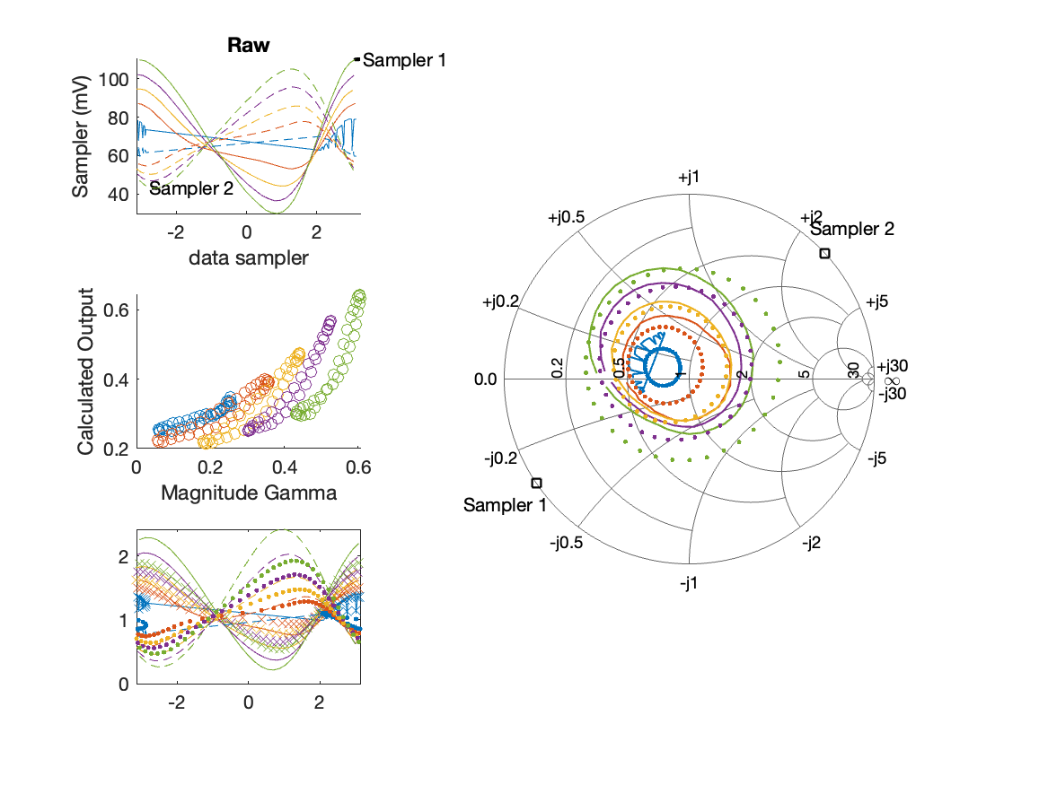
Sampler Performance Frequency 10.40 GHz, Power 22 dBm
Sampler Av
Sampler 1: 8.376
Sampler 2: 11.736
Sampler Offset (rather than -1)
-1.268
Goodness Of fit
0.54898

Slide 10
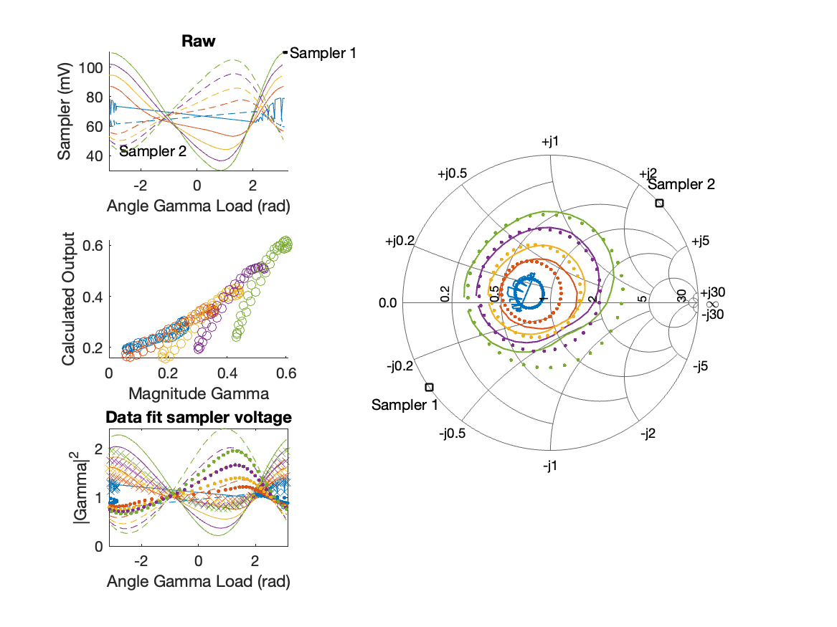
Sampler Performance x^3 Frequency 10.40 GHz, Power 22 dBm
Sampler Av
Sampler 1: 2.545527e+00
Sampler 2: 3.490
Sampler Av3
Sampler 1: 6.677
Sampler 2: 7.355
Sampler Offset (rather than -1)
-0.56354
Goodness Of fit
0.21639

Slide 11
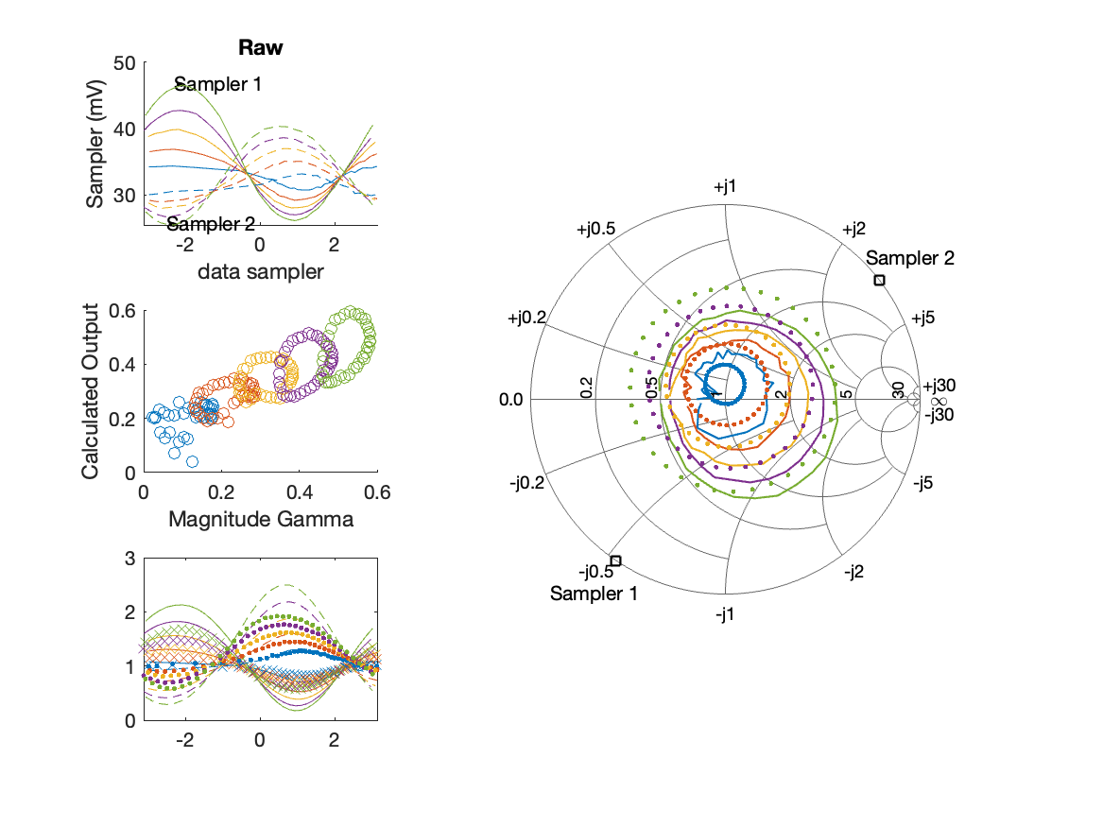
Sampler Performance Frequency 10.90 GHz, Power 14 dBm
Sampler Av
Sampler 1: 27.096
Sampler 2: 44.964
Sampler Offset (rather than -1)
-2.2623
Goodness Of fit
0.66603

Slide 12
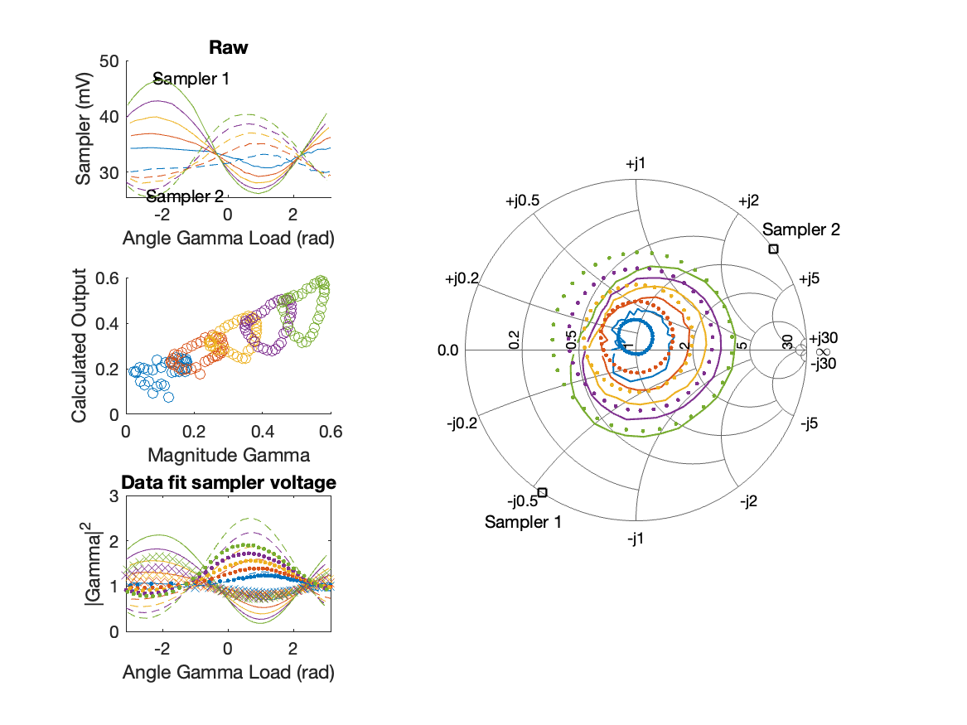
Sampler Performance x^3 Frequency 10.90 GHz, Power 14 dBm
Sampler Av
Sampler 1: 2.488224e+00
Sampler 2: 0.000
Sampler Av3
Sampler 1: 17.151
Sampler 2: 22.550
Sampler Offset (rather than -1)
-0.58173
Goodness Of fit
0.52852

Slide 13
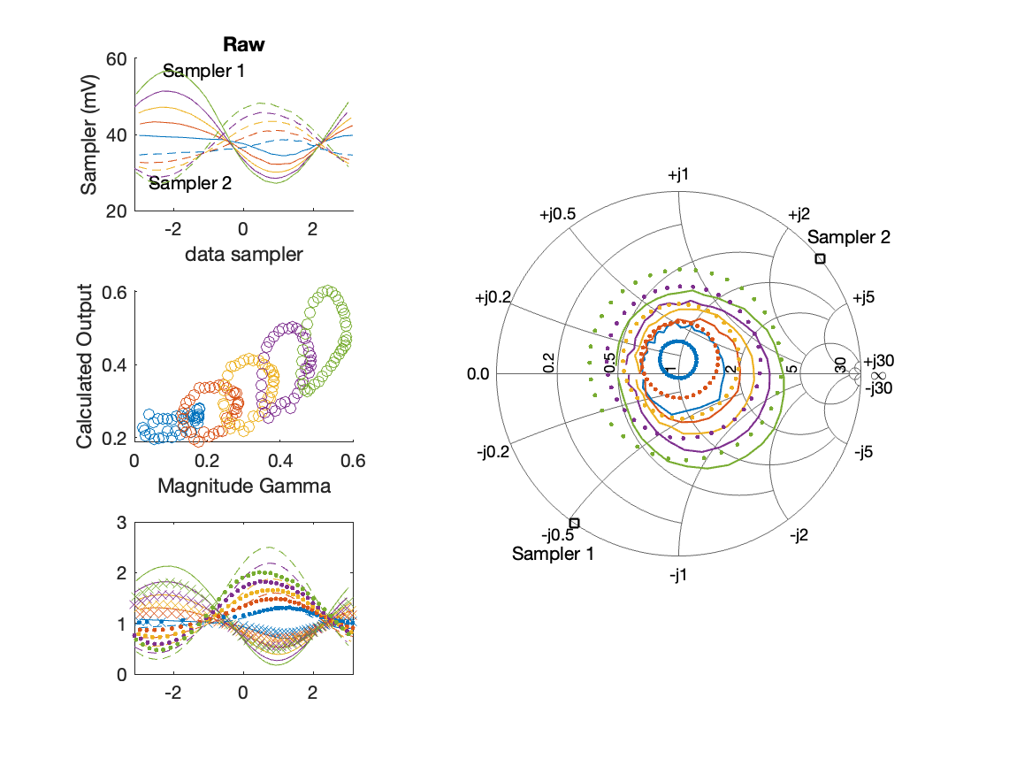
Sampler Performance Frequency 10.90 GHz, Power 16 dBm
Sampler Av
Sampler 1: 22.042
Sampler 2: 36.319
Sampler Offset (rather than -1)
-2.0938
Goodness Of fit
0.70655

Slide 14
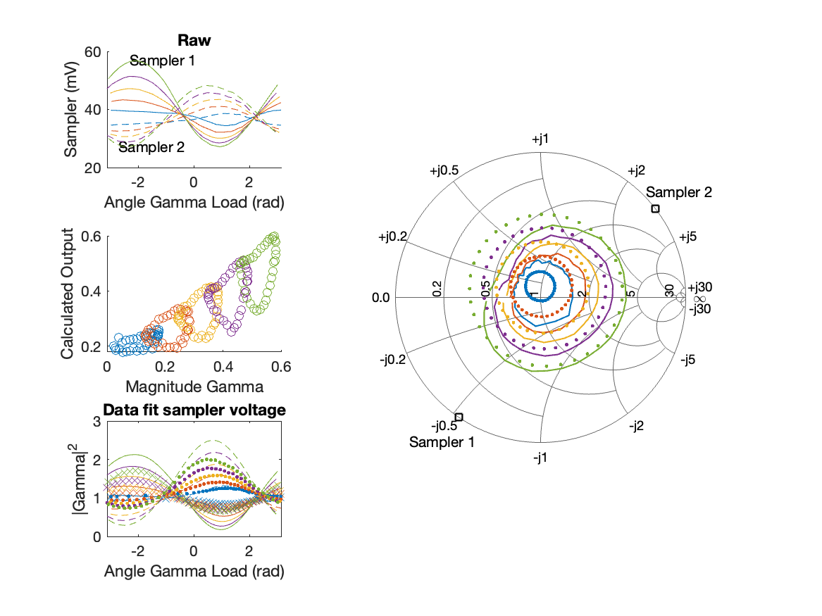
Sampler Performance x^3 Frequency 10.90 GHz, Power 16 dBm
Sampler Av
Sampler 1: 8.207826e+00
Sampler 2: 0.000
Sampler Av3
Sampler 1: 12.078
Sampler 2: 18.993
Sampler Offset (rather than -1)
-0.68833
Goodness Of fit
0.52483

Slide 15

Sampler Performance Frequency 10.90 GHz, Power 18 dBm
Sampler Av
Sampler 1: 17.811
Sampler 2: 29.228
Sampler Offset (rather than -1)
-1.9843
Goodness Of fit
0.7328

Slide 16
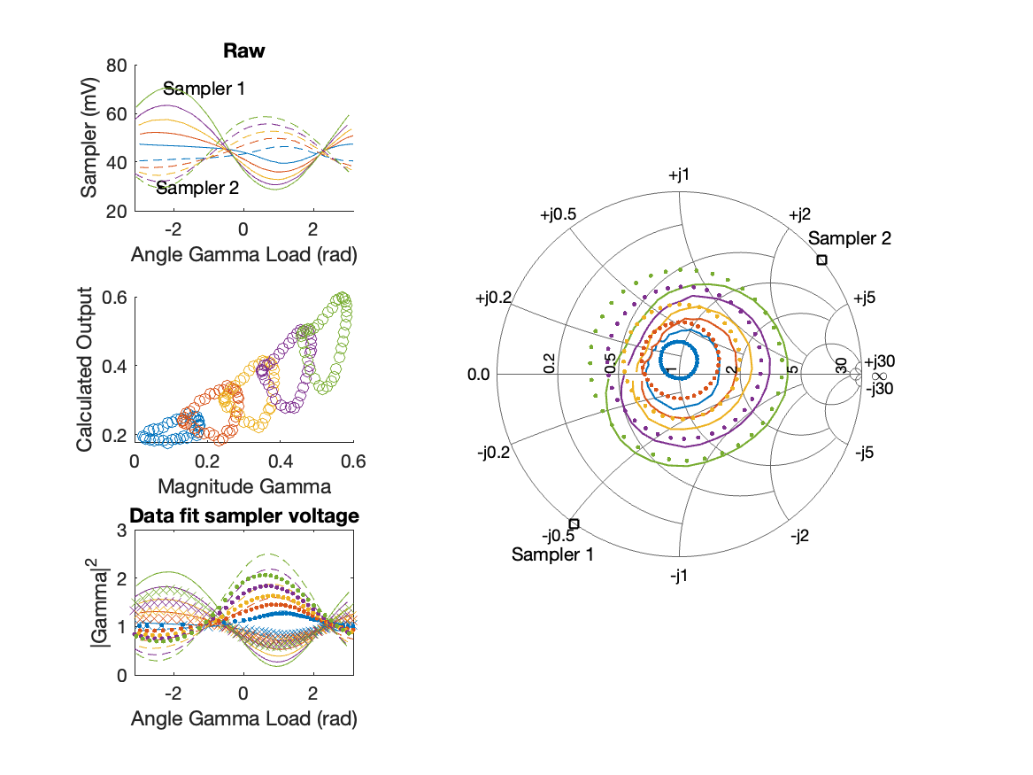
Sampler Performance x^3 Frequency 10.90 GHz, Power 18 dBm
Sampler Av
Sampler 1: 9.527406e+00
Sampler 2: 0.000
Sampler Av3
Sampler 1: 8.350
Sampler 2: 15.728
Sampler Offset (rather than -1)
-0.73778
Goodness Of fit
0.50741

Slide 17
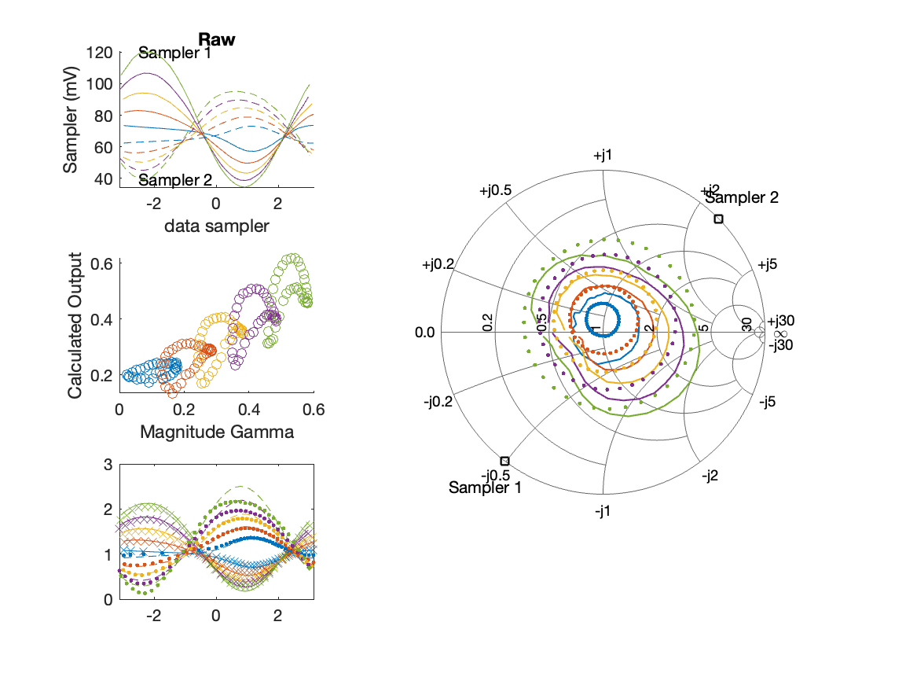
Sampler Performance Frequency 10.90 GHz, Power 22 dBm
Sampler Av
Sampler 1: 10.403
Sampler 2: 18.131
Sampler Offset (rather than -1)
-1.8591
Goodness Of fit
0.50108

Slide 18
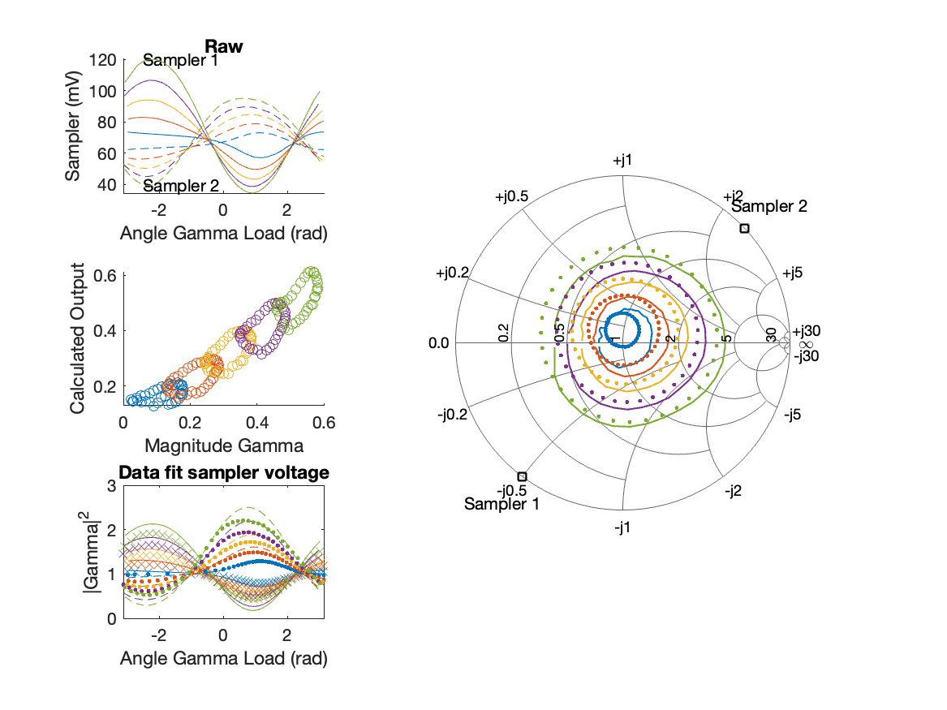
Sampler Performance x^3 Frequency 10.90 GHz, Power 22 dBm
Sampler Av
Sampler 1: 7.216630e+00
Sampler 2: 3.275
Sampler Av3
Sampler 1: 4.147
Sampler 2: 9.359
Sampler Offset (rather than -1)
-0.93994
Goodness Of fit
0.2251

Slide 19
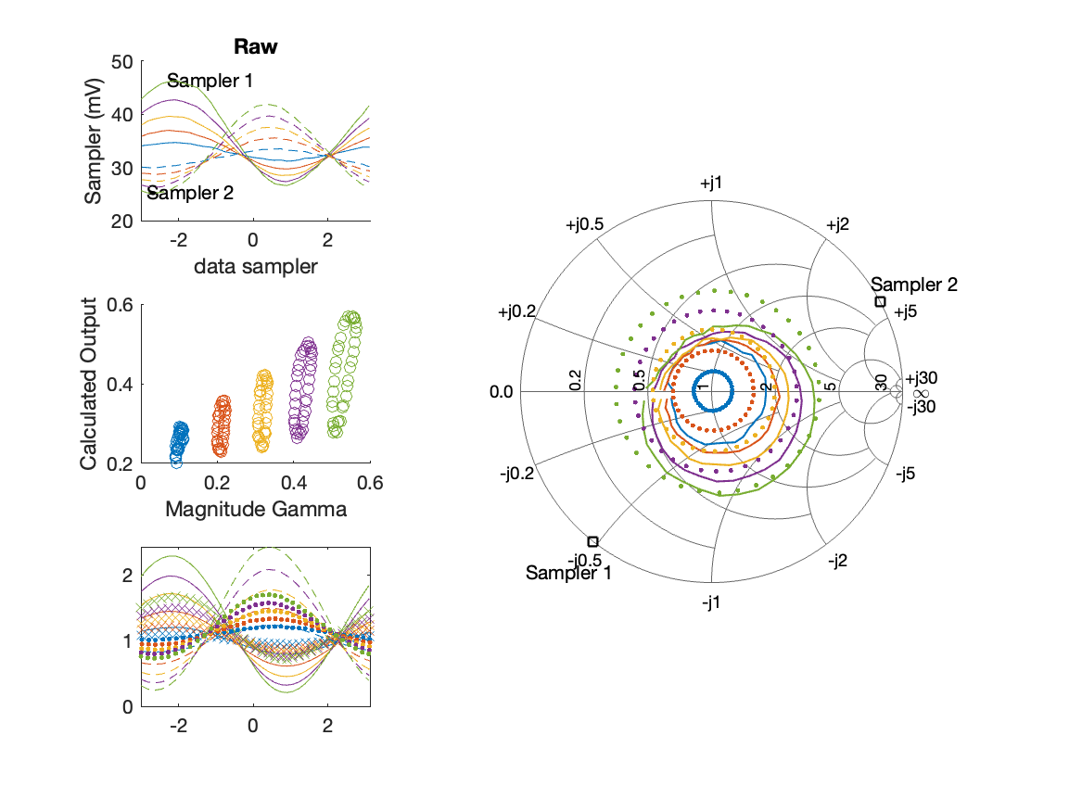
Sampler Performance Frequency 11.40 GHz, Power 14 dBm
Sampler Av
Sampler 1: 24.076
Sampler 2: 28.970
Sampler Offset (rather than -1)
-1.6457
Goodness Of fit
0.8638

Slide 20
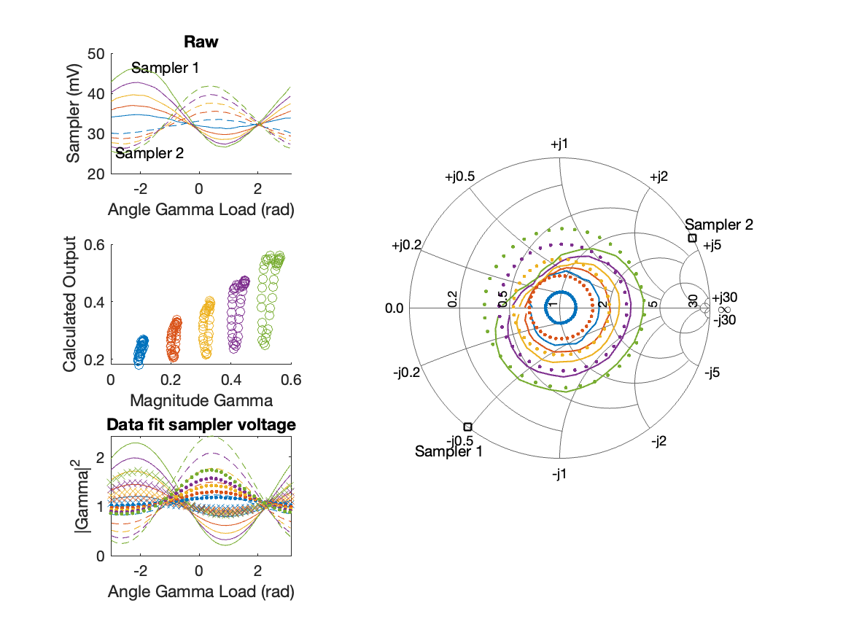
Sampler Performance x^3 Frequency 11.40 GHz, Power 14 dBm
Sampler Av
Sampler 1: 4.870783e-10
Sampler 2: 0.000
Sampler Av3
Sampler 1: 17.645
Sampler 2: 19.806
Sampler Offset (rather than -1)
-0.3909
Goodness Of fit
0.66158

Slide 21
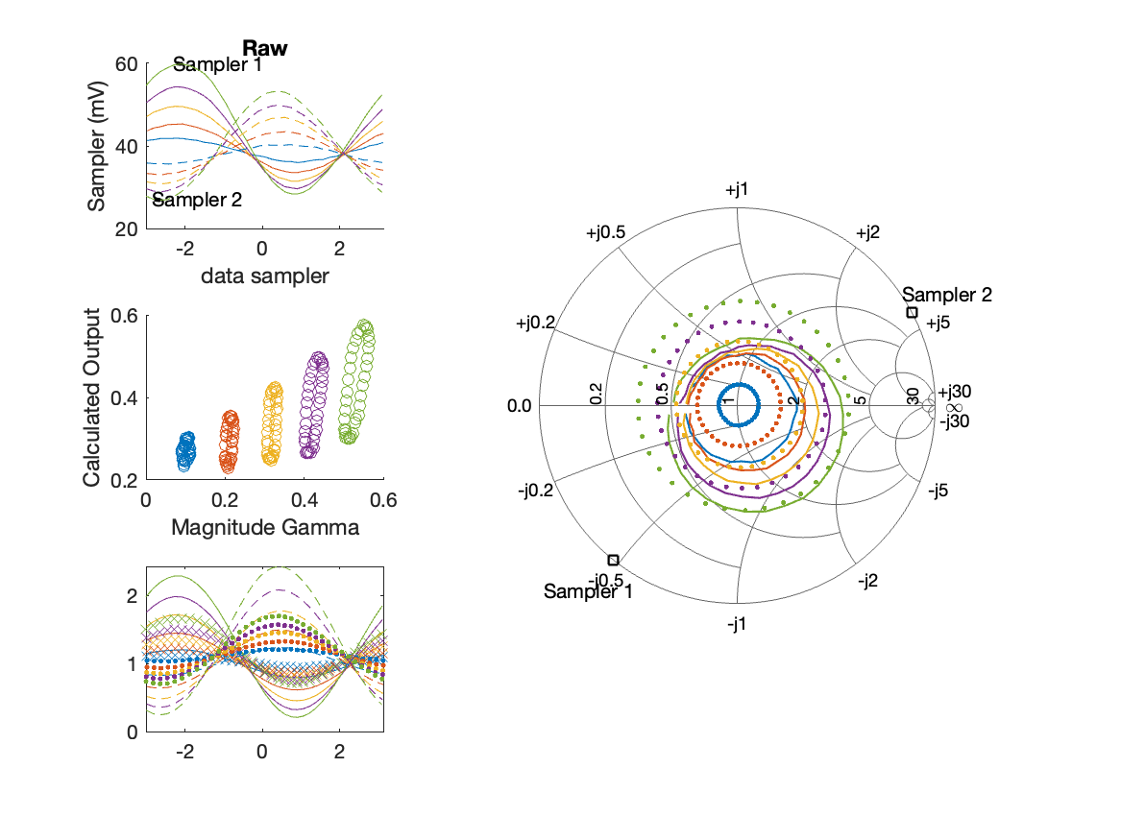
Sampler Performance Frequency 11.40 GHz, Power 16 dBm
Sampler Av
Sampler 1: 15.159
Sampler 2: 18.835
Sampler Offset (rather than -1)
-1.232
Goodness Of fit
0.91287

Slide 22
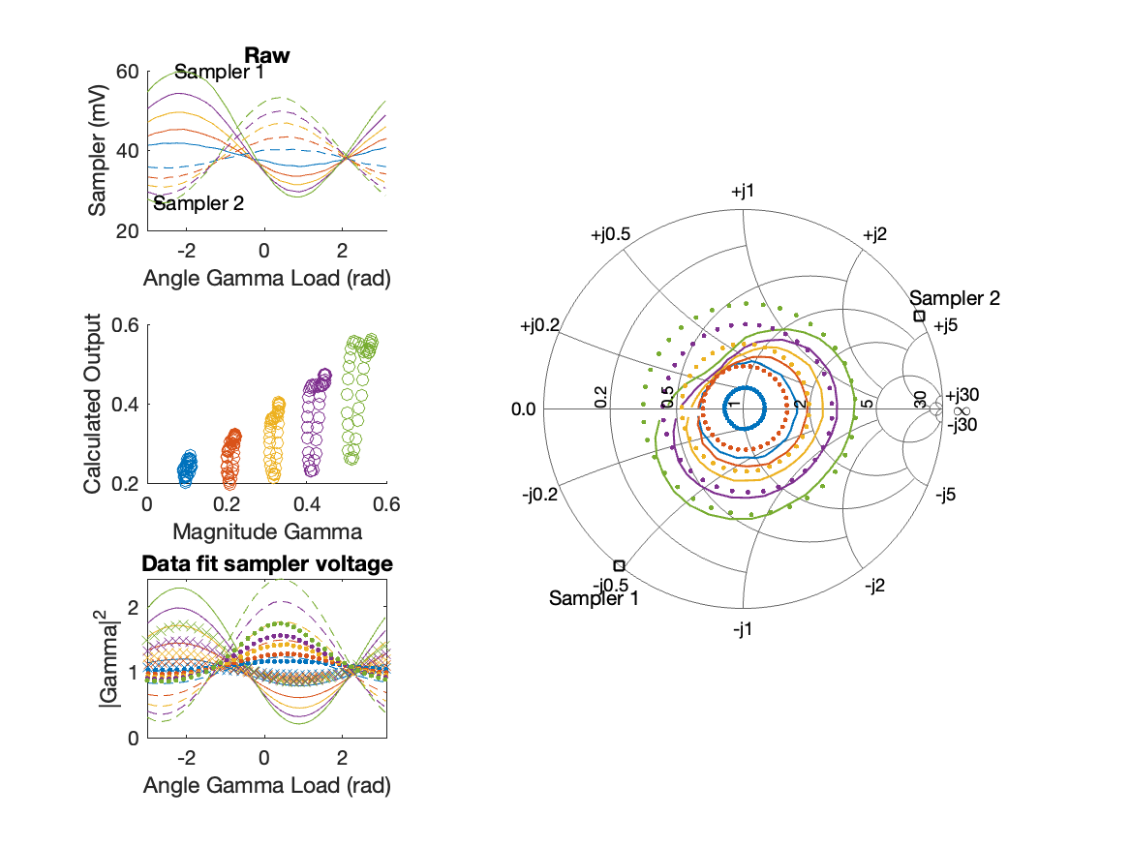
Sampler Performance x^3 Frequency 11.40 GHz, Power 16 dBm
Sampler Av
Sampler 1: 1.932831e-07
Sampler 2: 0.000
Sampler Av3
Sampler 1: 13.123
Sampler 2: 14.966
Sampler Offset (rather than -1)
-0.26166
Goodness Of fit
0.64362

Slide 23
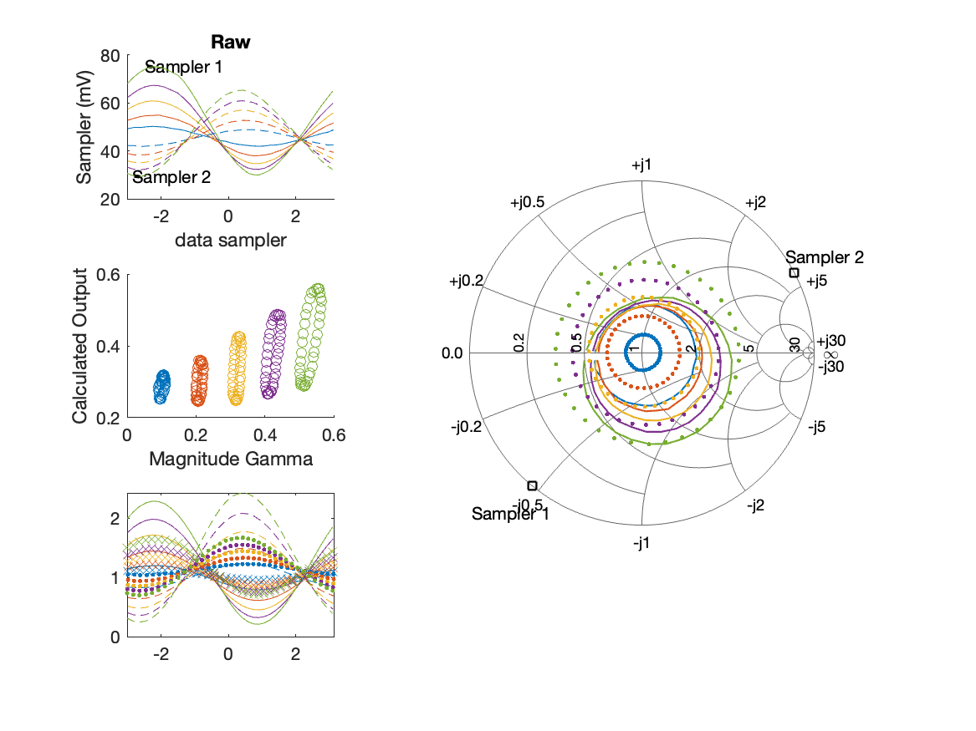
Sampler Performance Frequency 11.40 GHz, Power 18 dBm
Sampler Av
Sampler 1: 10.366
Sampler 2: 13.456
Sampler Offset (rather than -1)
-1.0031
Goodness Of fit
1.0392

Slide 24

Sampler Performance x^3 Frequency 11.40 GHz, Power 18 dBm
Sampler Av
Sampler 1: 6.751857e-08
Sampler 2: 0.000
Sampler Av3
Sampler 1: 10.230
Sampler 2: 11.902
Sampler Offset (rather than -1)
-0.20167
Goodness Of fit
0.69792

Slide 25
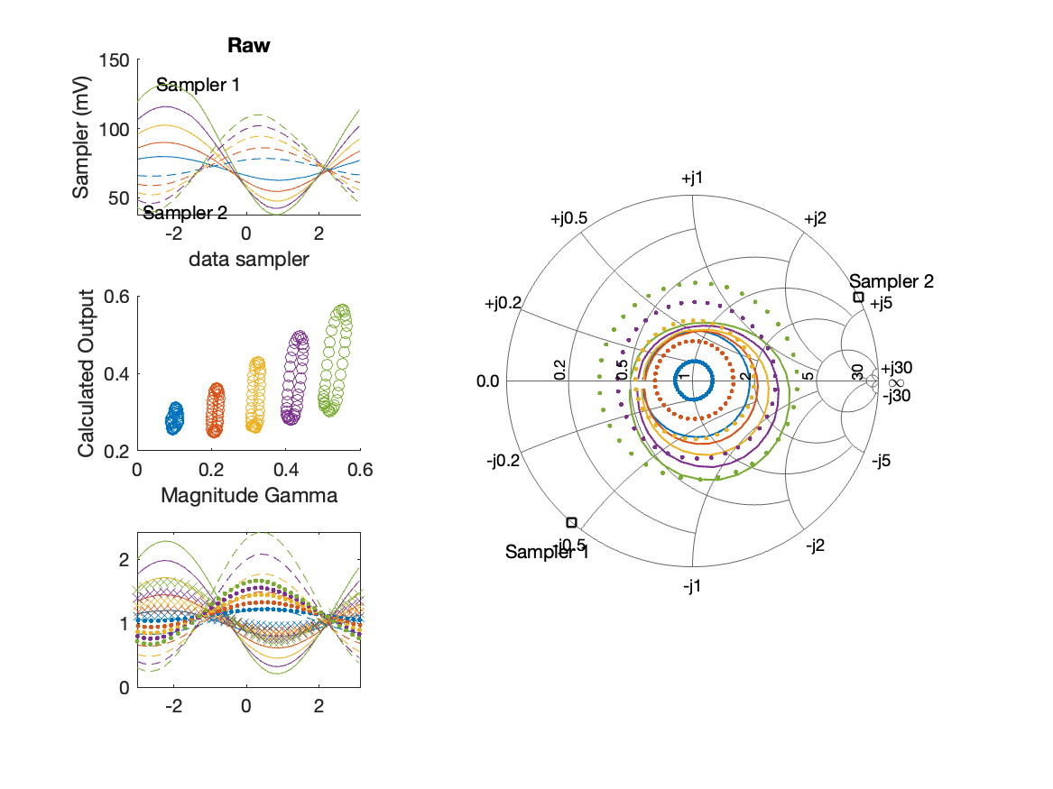
Sampler Performance Frequency 11.40 GHz, Power 22 dBm
Sampler Av
Sampler 1: 4.981
Sampler 2: 7.062
Sampler Offset (rather than -1)
-0.78062
Goodness Of fit
1.0257

Slide 26
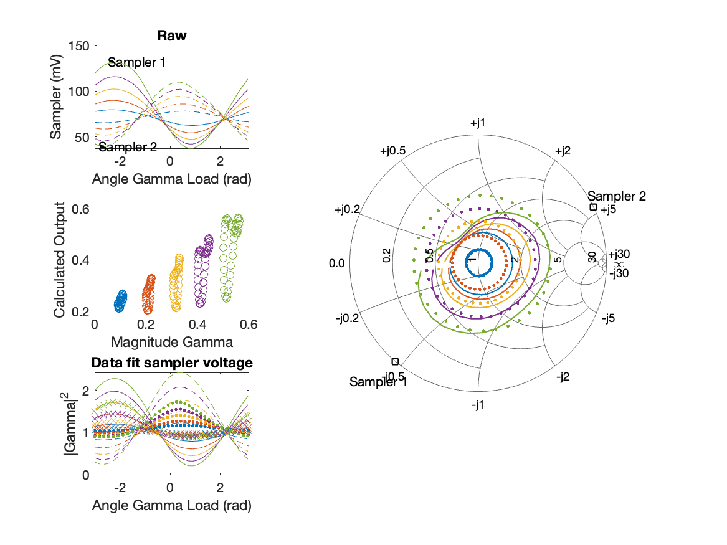
Sampler Performance x^3 Frequency 11.40 GHz, Power 22 dBm
Sampler Av
Sampler 1: 1.832300e-01
Sampler 2: 0.000
Sampler Av3
Sampler 1: 5.589
Sampler 2: 6.895
Sampler Offset (rather than -1)
-0.14193
Goodness Of fit
0.65373

Slide 27
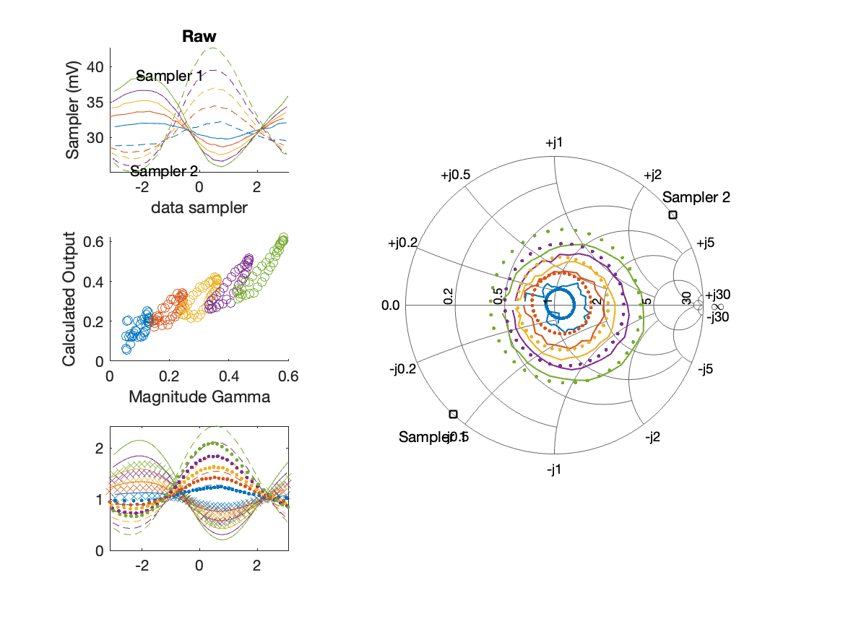
Sampler Performance Frequency 11.90 GHz, Power 14 dBm
Sampler Av
Sampler 1: 47.742
Sampler 2: 40.803
Sampler Offset (rather than -1)
-2.6971
Goodness Of fit
0.28252

Slide 28
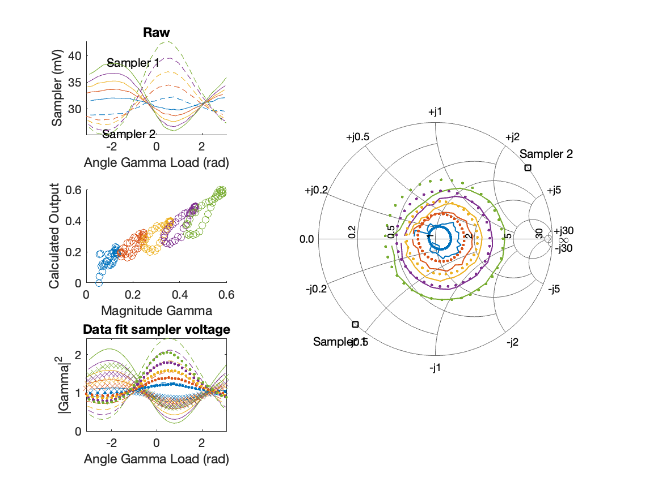
Sampler Performance x^3 Frequency 11.90 GHz, Power 14 dBm
Sampler Av
Sampler 1: 1.118056e-08
Sampler 2: 28.044
Sampler Av3
Sampler 1: 24.024
Sampler 2: 13.953
Sampler Offset (rather than -1)
-1.3228
Goodness Of fit
0.21816

Slide 29
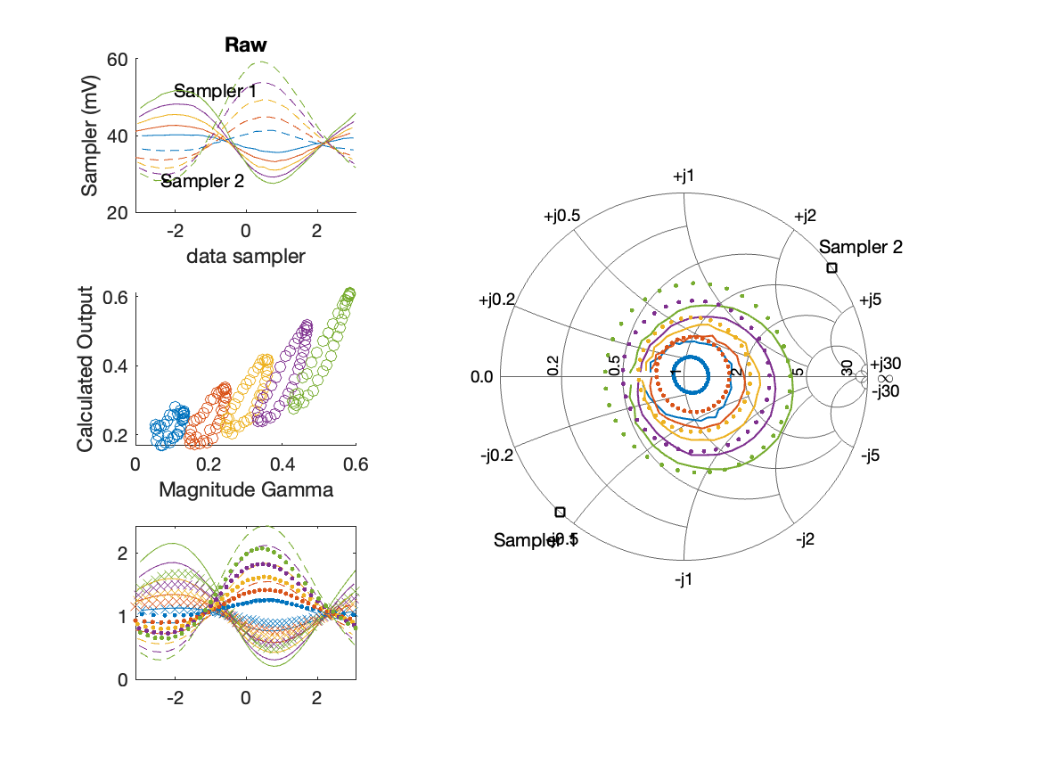
Sampler Performance Frequency 11.90 GHz, Power 16 dBm
Sampler Av
Sampler 1: 24.709
Sampler 2: 22.807
Sampler Offset (rather than -1)
-1.7655
Goodness Of fit
0.42224

Slide 30
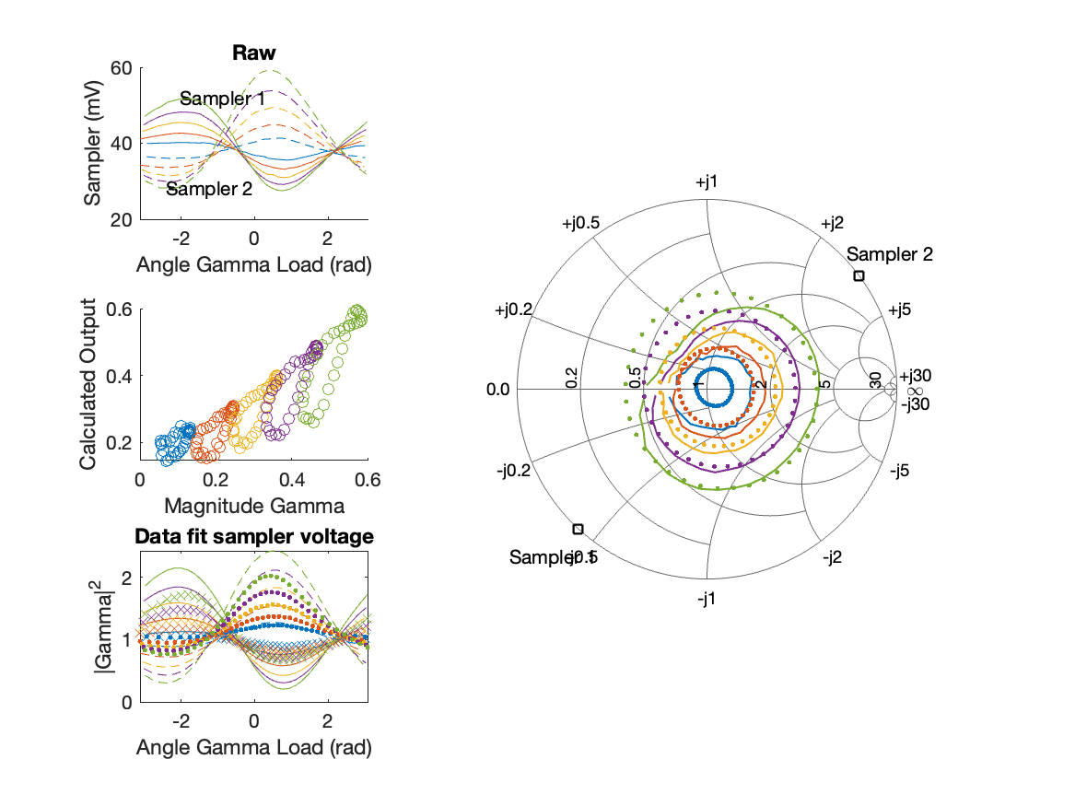
Sampler Performance x^3 Frequency 11.90 GHz, Power 16 dBm
Sampler Av
Sampler 1: 1.898963e-07
Sampler 2: 13.637
Sampler Av3
Sampler 1: 16.458
Sampler 2: 10.320
Sampler Offset (rather than -1)
-0.79269
Goodness Of fit
0.29588

Slide 31

Sampler Performance Frequency 11.90 GHz, Power 18 dBm
Sampler Av
Sampler 1: 16.101
Sampler 2: 15.770
Sampler Offset (rather than -1)
-1.3879
Goodness Of fit
0.55399

Slide 32
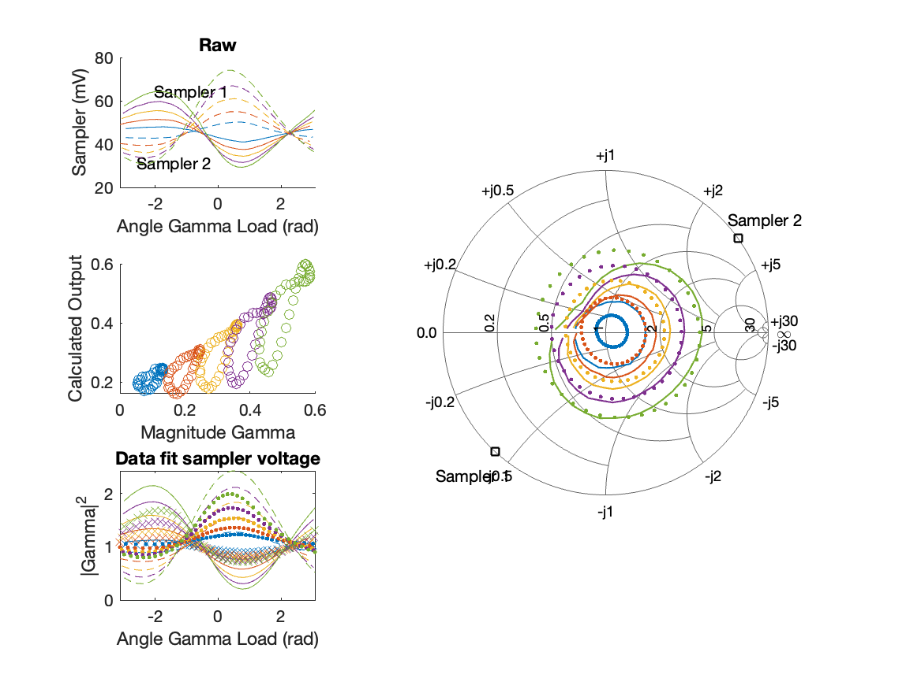
Sampler Performance x^3 Frequency 11.90 GHz, Power 18 dBm
Sampler Av
Sampler 1: 2.395406e-05
Sampler 2: 7.710
Sampler Av3
Sampler 1: 12.635
Sampler 2: 8.866
Sampler Offset (rather than -1)
-0.56166
Goodness Of fit
0.36231

Slide 33

Sampler Performance Frequency 11.90 GHz, Power 22 dBm
Sampler Av
Sampler 1: 6.107
Sampler 2: 6.752
Sampler Offset (rather than -1)
-0.88573
Goodness Of fit
0.72952

Slide 34

Sampler Performance x^3 Frequency 11.90 GHz, Power 22 dBm
Sampler Av
Sampler 1: 9.716592e-08
Sampler 2: 2.448
Sampler Av3
Sampler 1: 6.526
Sampler 2: 5.147
Sampler Offset (rather than -1)
-0.30429
Goodness Of fit
0.45021

Slide 35
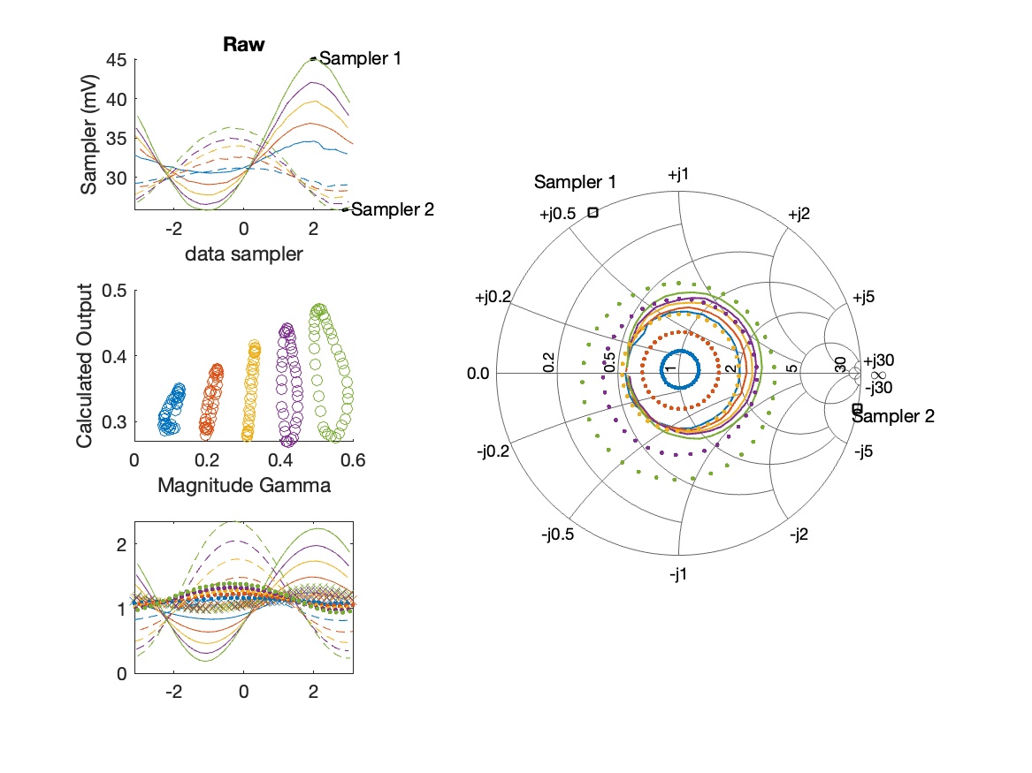
Sampler Performance Frequency 8.90 GHz, Power 14 dBm
Sampler Av
Sampler 1: 8.850
Sampler 2: 21.179
Sampler Offset (rather than -1)
-0.82406
Goodness Of fit
1.5219

Slide 36
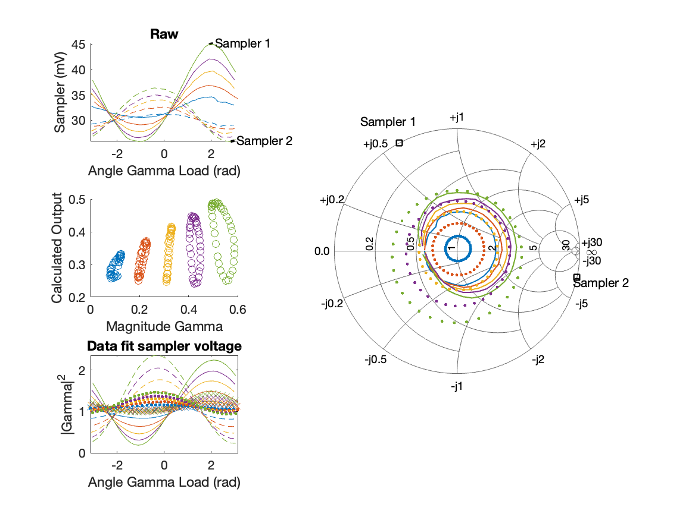
Sampler Performance x^3 Frequency 8.90 GHz, Power 14 dBm
Sampler Av
Sampler 1: 2.705919e-14
Sampler 2: 0.000
Sampler Av3
Sampler 1: 14.538
Sampler 2: 20.434
Sampler Offset (rather than -1)
-0.25167
Goodness Of fit
1.3321

Slide 37
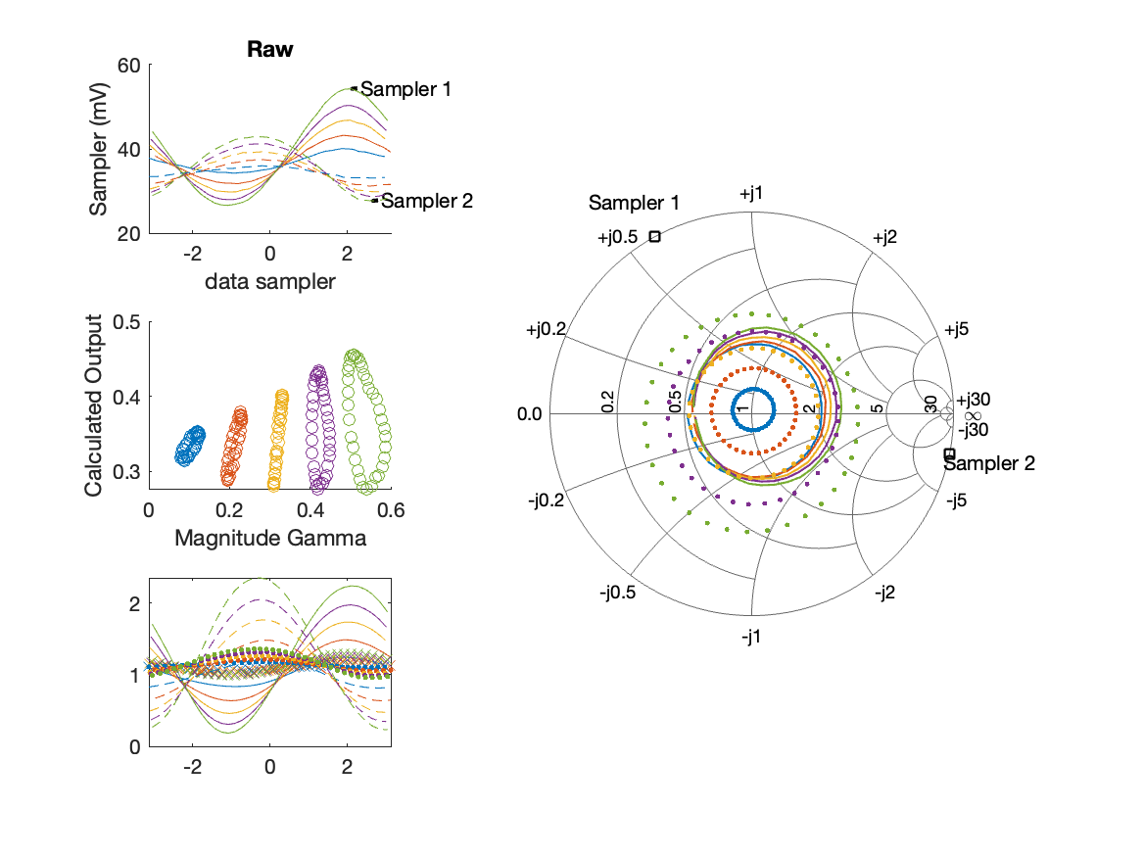
Sampler Performance Frequency 8.90 GHz, Power 16 dBm
Sampler Av
Sampler 1: 5.533
Sampler 2: 13.119
Sampler Offset (rather than -1)
-0.5453
Goodness Of fit
1.6008

Slide 38
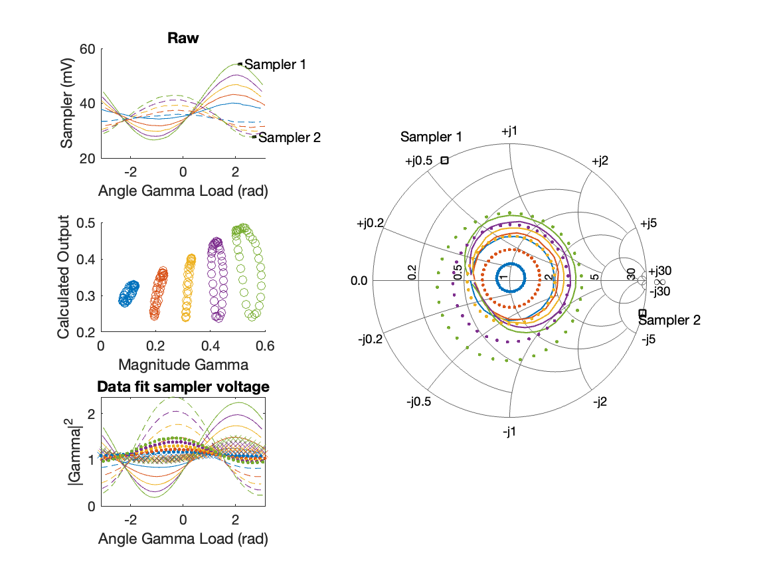
Sampler Performance x^3 Frequency 8.90 GHz, Power 16 dBm
Sampler Av
Sampler 1: 3.138406e-14
Sampler 2: 0.000
Sampler Av3
Sampler 1: 11.917
Sampler 2: 16.612
Sampler Offset (rather than -1)
-0.18061
Goodness Of fit
1.3452

Slide 39
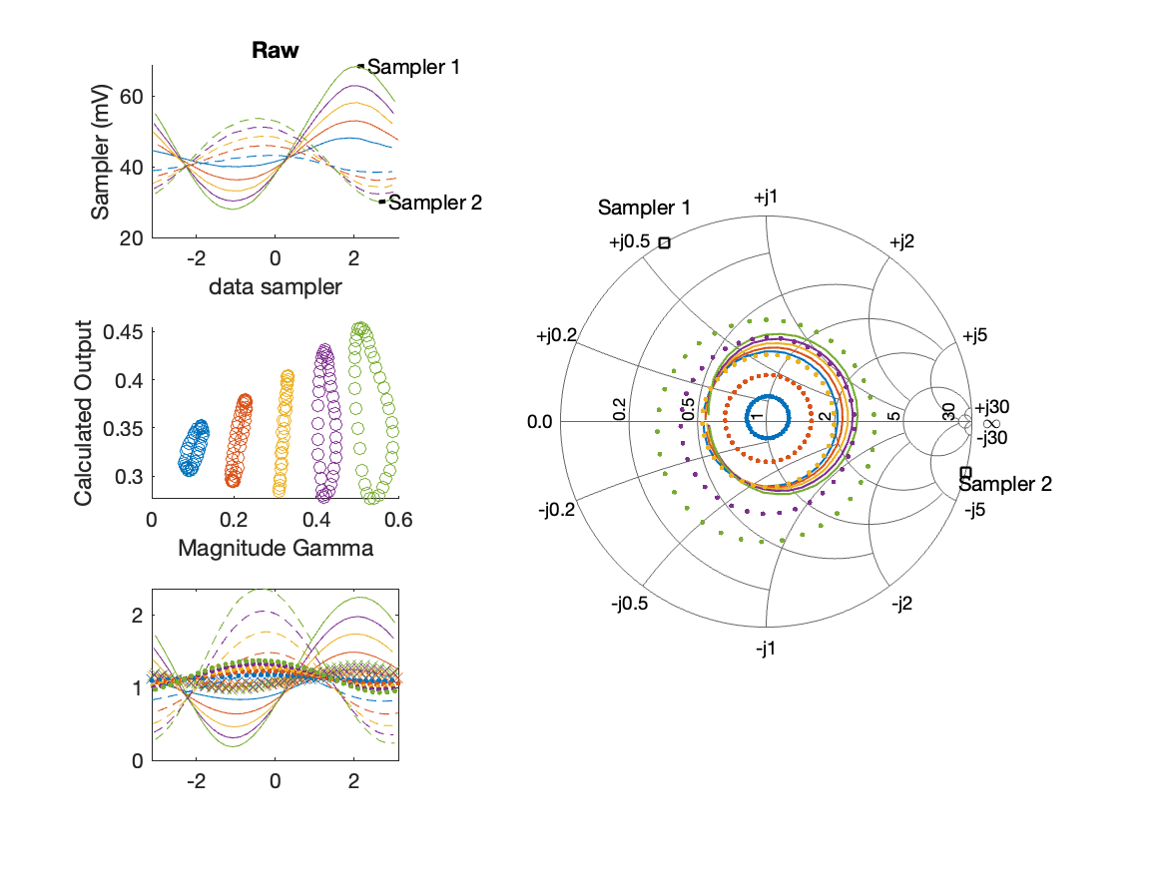
Sampler Performance Frequency 8.90 GHz, Power 18 dBm
Sampler Av
Sampler 1: 4.183
Sampler 2: 9.289
Sampler Offset (rather than -1)
-0.45425
Goodness Of fit
1.5999

Slide 40
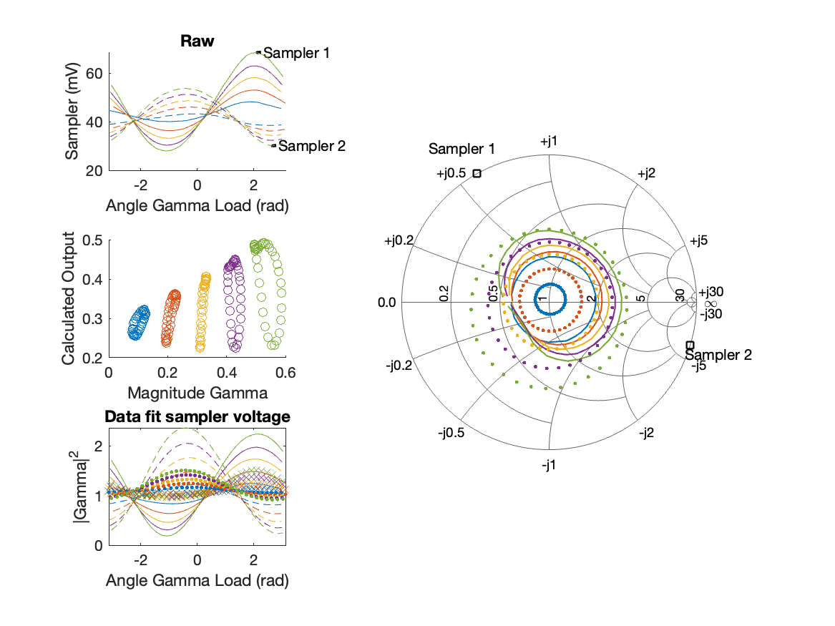
Sampler Performance x^3 Frequency 8.90 GHz, Power 18 dBm
Sampler Av
Sampler 1: 2.241396e-14
Sampler 2: 0.000
Sampler Av3
Sampler 1: 9.696
Sampler 2: 13.254
Sampler Offset (rather than -1)
-0.15264
Goodness Of fit
1.2625

Slide 41
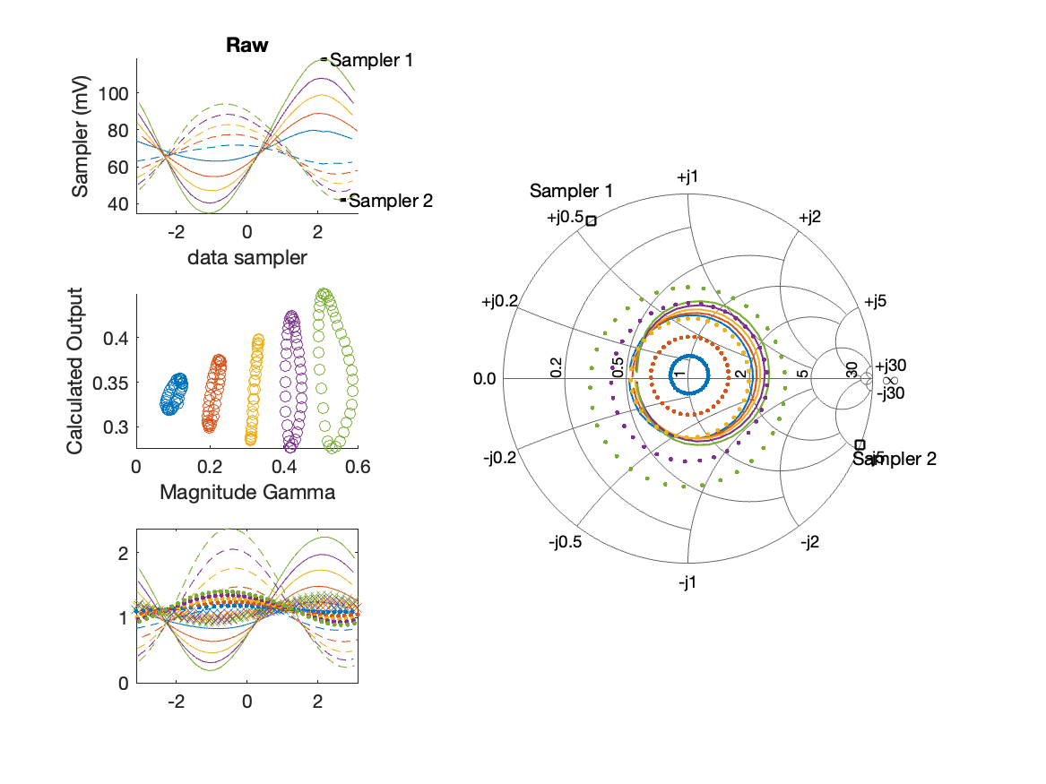
Sampler Performance Frequency 8.90 GHz, Power 22 dBm
Sampler Av
Sampler 1: 2.455
Sampler 2: 4.930
Sampler Offset (rather than -1)
-0.39063
Goodness Of fit
1.6233

Slide 42
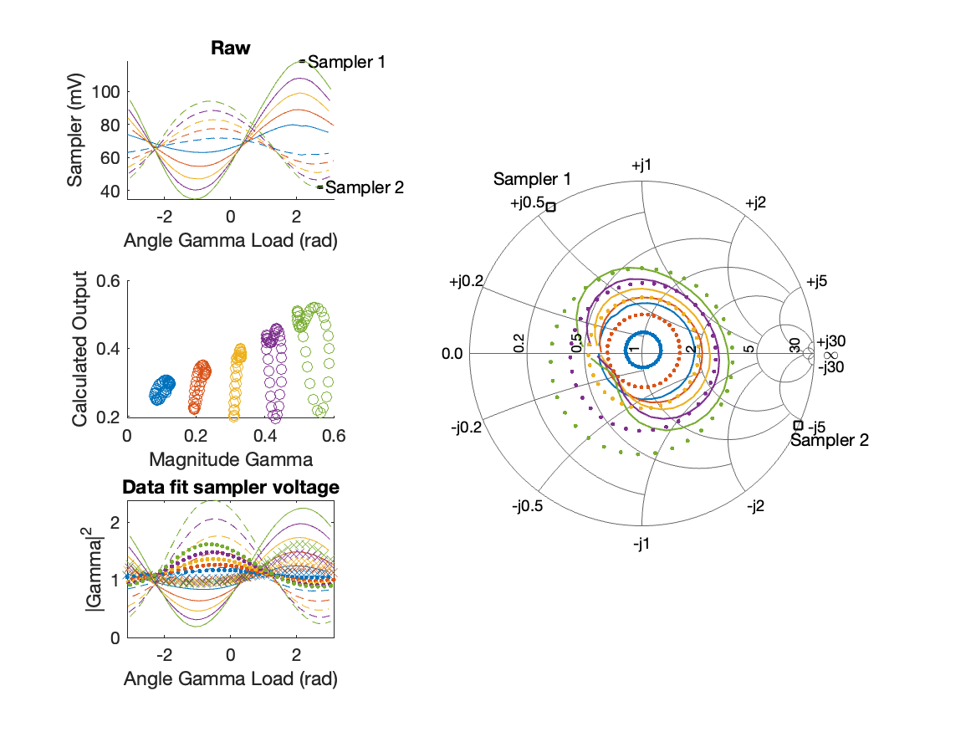
Sampler Performance x^3 Frequency 8.90 GHz, Power 22 dBm
Sampler Av
Sampler 1: 2.224983e-14
Sampler 2: 0.000
Sampler Av3
Sampler 1: 5.969
Sampler 2: 7.850
Sampler Offset (rather than -1)
-0.14483
Goodness Of fit
1.1104

Slide 43
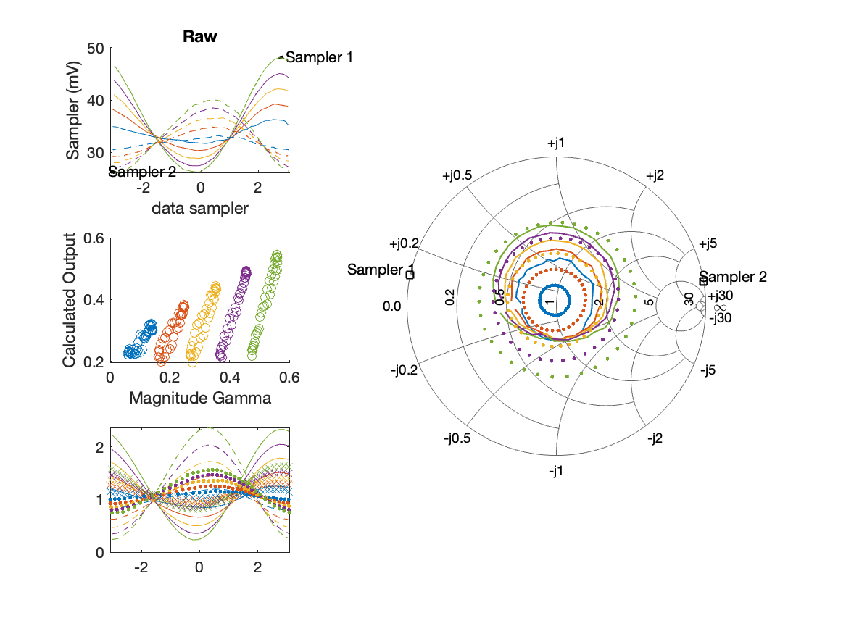
Sampler Performance Frequency 9.40 GHz, Power 14 dBm
Sampler Av
Sampler 1: 18.715
Sampler 2: 29.492
Sampler Offset (rather than -1)
-1.4998
Goodness Of fit
0.86689

Slide 44
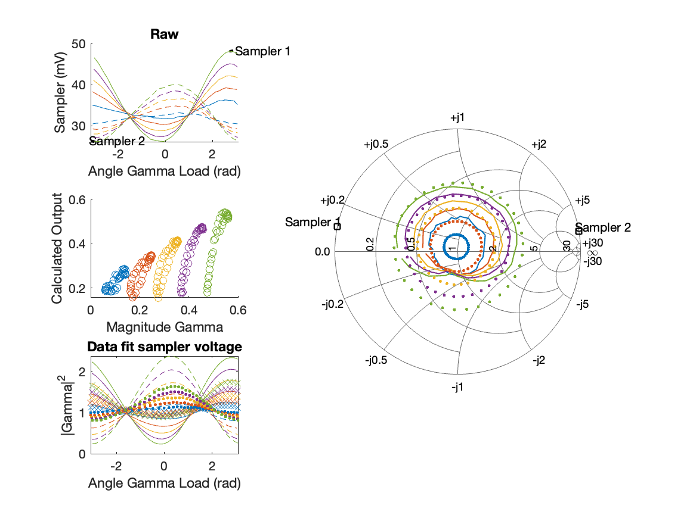
Sampler Performance x^3 Frequency 9.40 GHz, Power 14 dBm
Sampler Av
Sampler 1: 4.594846e-12
Sampler 2: 0.000
Sampler Av3
Sampler 1: 16.613
Sampler 2: 20.703
Sampler Offset (rather than -1)
-0.41011
Goodness Of fit
0.60222

Slide 45

Sampler Performance Frequency 9.40 GHz, Power 16 dBm
Sampler Av
Sampler 1: 14.538
Sampler 2: 22.276
Sampler Offset (rather than -1)
-1.2364
Goodness Of fit
0.92145

Slide 46
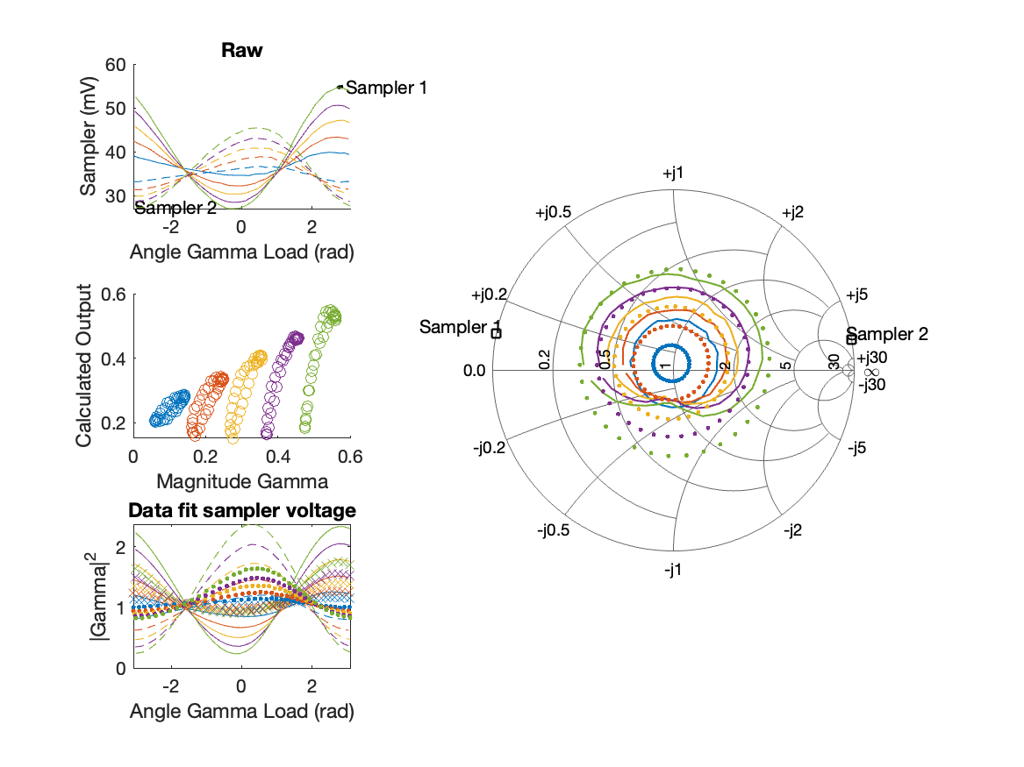
Sampler Performance x^3 Frequency 9.40 GHz, Power 16 dBm
Sampler Av
Sampler 1: 2.281369e-14
Sampler 2: 0.000
Sampler Av3
Sampler 1: 14.369
Sampler 2: 17.715
Sampler Offset (rather than -1)
-0.3297
Goodness Of fit
0.60692

Slide 47
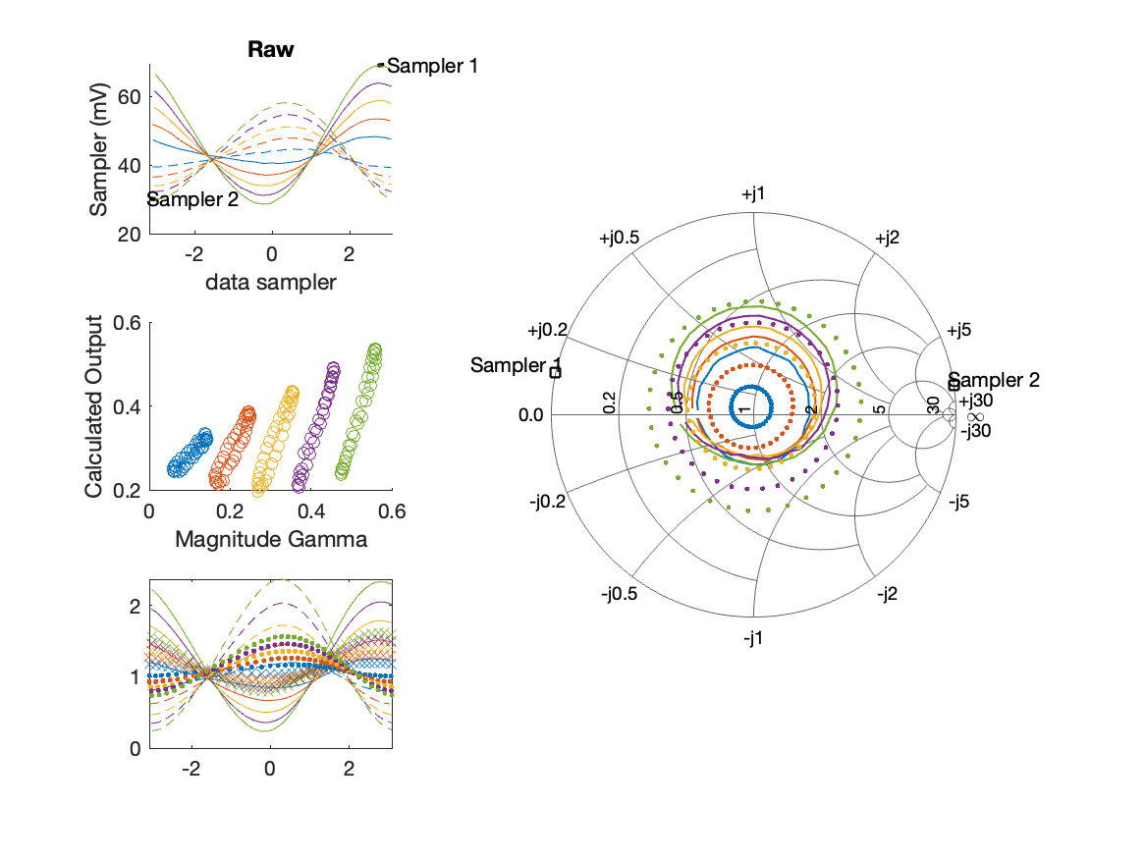
Sampler Performance Frequency 9.40 GHz, Power 18 dBm
Sampler Av
Sampler 1: 10.156
Sampler 2: 14.670
Sampler Offset (rather than -1)
-0.98318
Goodness Of fit
0.95564

Slide 48
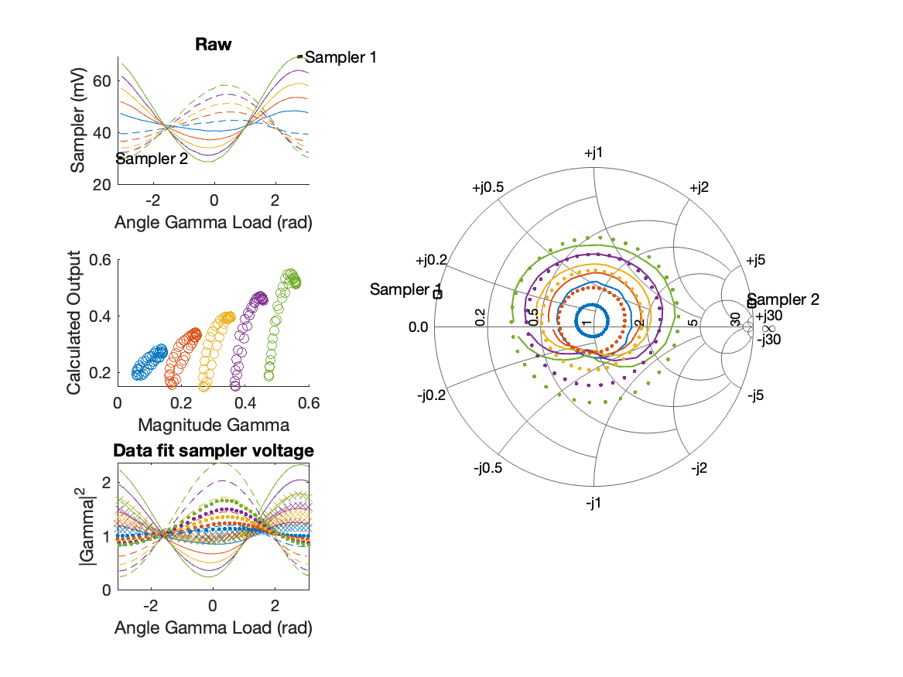
Sampler Performance x^3 Frequency 9.40 GHz, Power 18 dBm
Sampler Av
Sampler 1: 2.224824e-14
Sampler 2: 0.000
Sampler Av3
Sampler 1: 11.167
Sampler 2: 13.450
Sampler Offset (rather than -1)
-0.24614
Goodness Of fit
0.57356

Slide 49
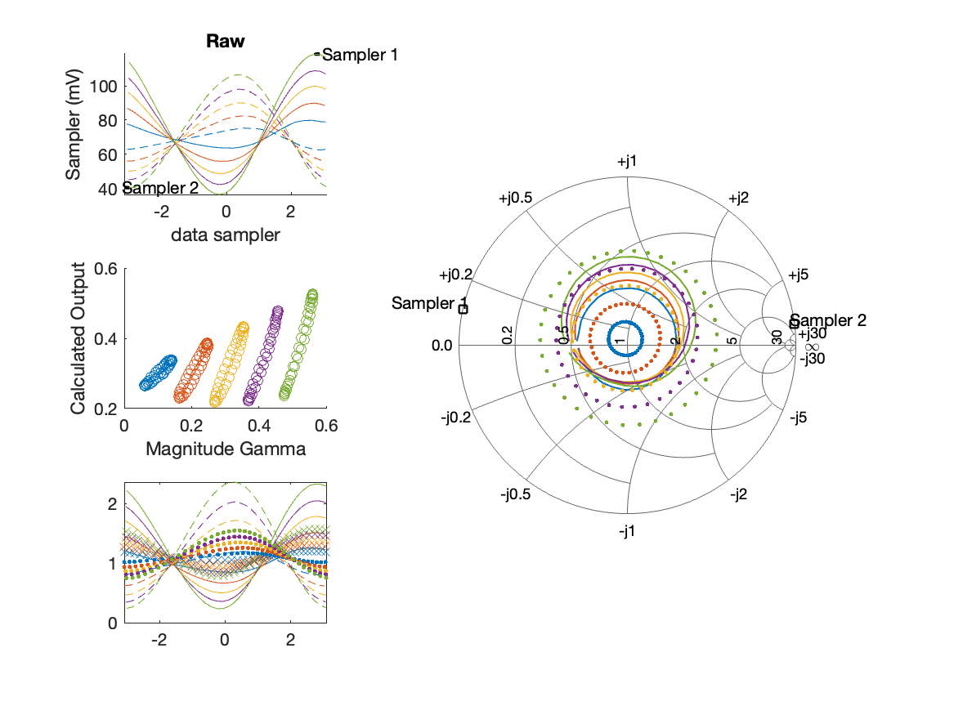
Sampler Performance Frequency 9.40 GHz, Power 22 dBm
Sampler Av
Sampler 1: 4.811
Sampler 2: 6.047
Sampler Offset (rather than -1)
-0.66968
Goodness Of fit
1.0623

Slide 50
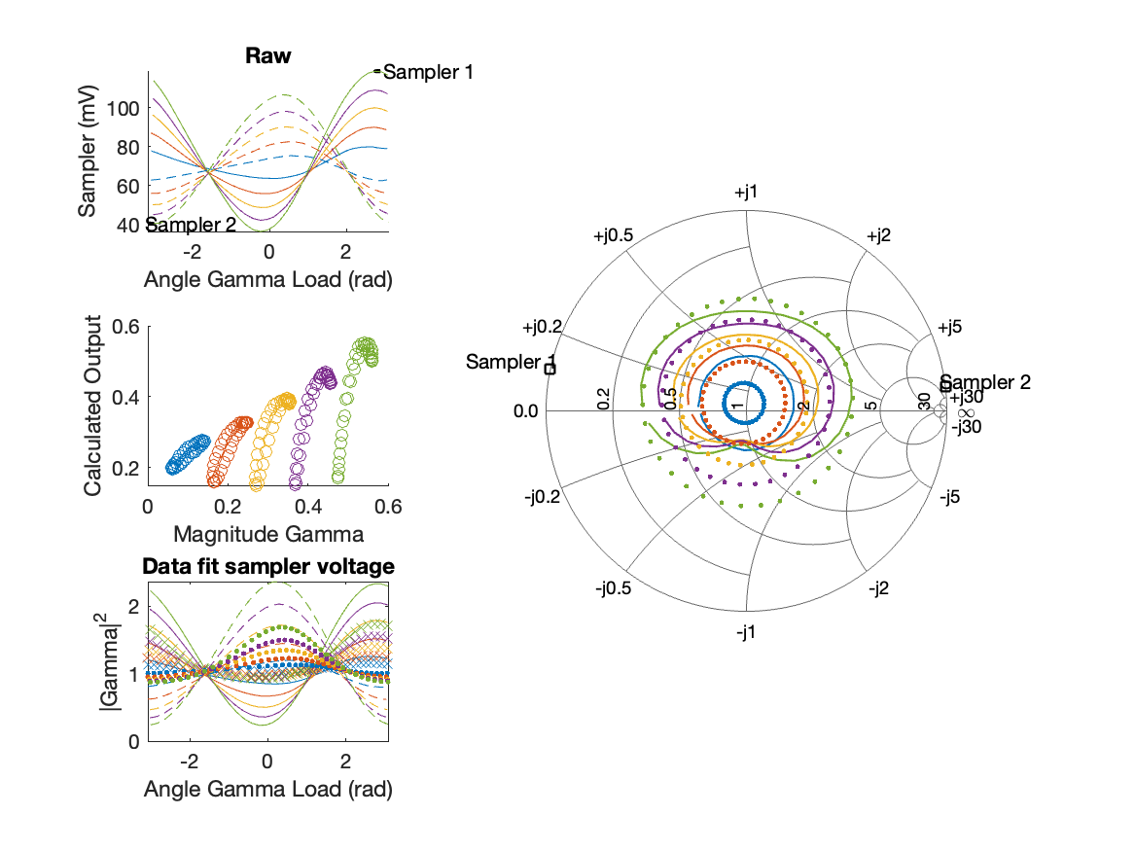
Sampler Performance x^3 Frequency 9.40 GHz, Power 22 dBm
Sampler Av
Sampler 1: 3.185432e-14
Sampler 2: 0.000
Sampler Av3
Sampler 1: 6.320
Sampler 2: 7.087
Sampler Offset (rather than -1)
-0.15389
Goodness Of fit
0.56995

Slide 51
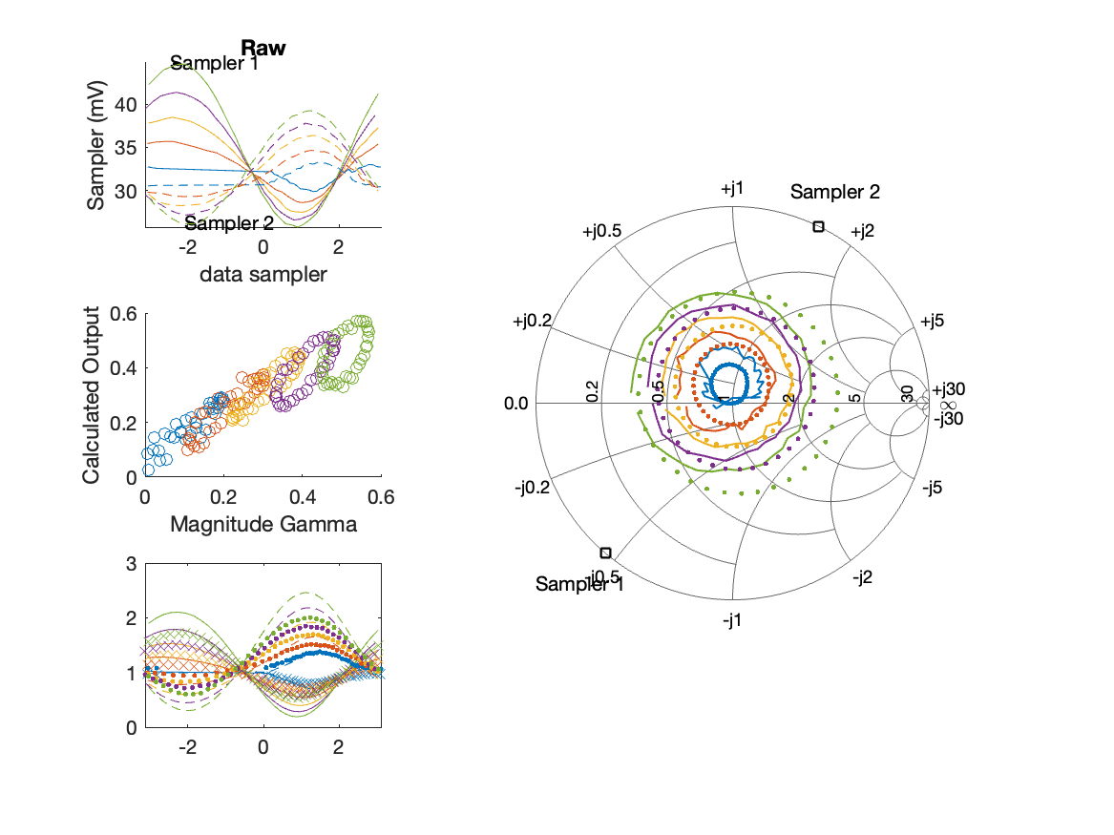
Sampler Performance Frequency 9.90 GHz, Power 14 dBm
Sampler Av
Sampler 1: 31.347
Sampler 2: 53.125
Sampler Offset (rather than -1)
-2.6379
Goodness Of fit
0.41672

Slide 52
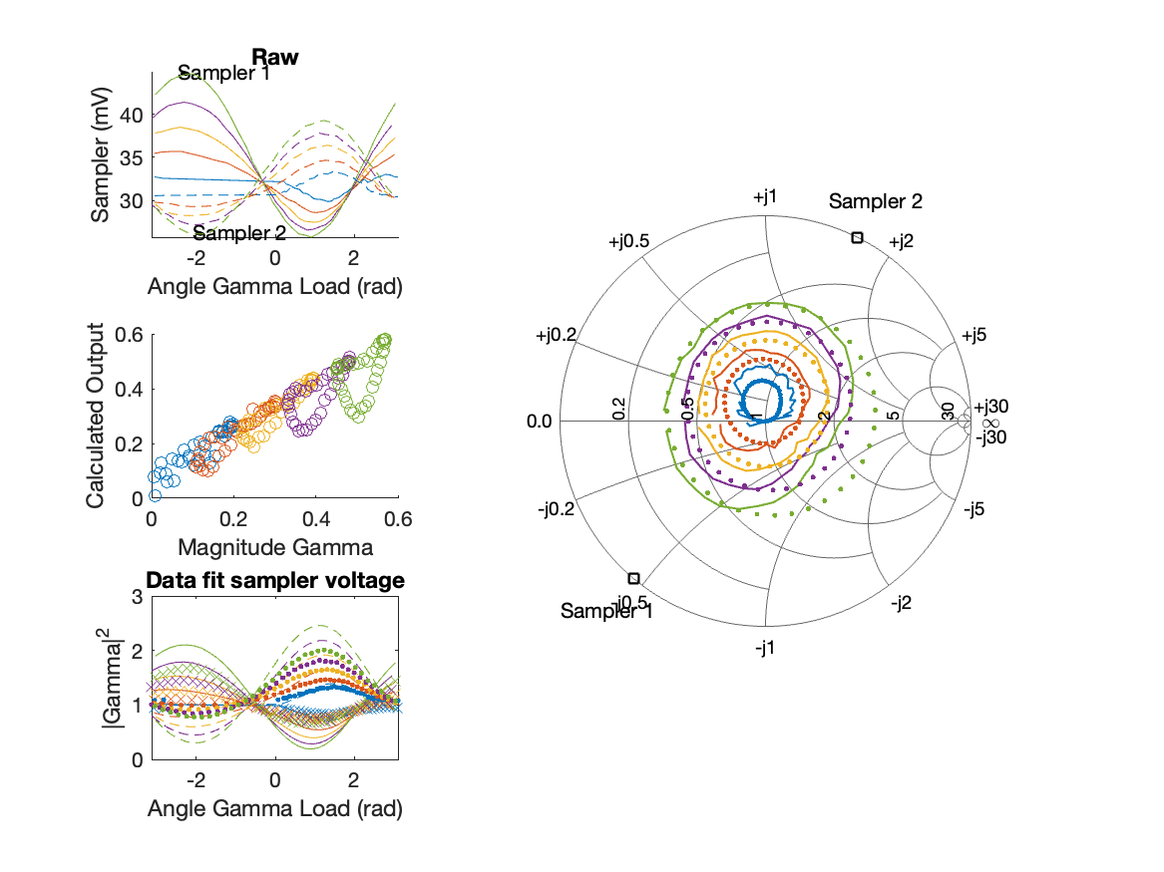
Sampler Performance x^3 Frequency 9.90 GHz, Power 14 dBm
Sampler Av
Sampler 1: 8.901305e+00
Sampler 2: 0.000
Sampler Av3
Sampler 1: 16.860
Sampler 2: 24.313
Sampler Offset (rather than -1)
-0.85998
Goodness Of fit
0.3134

Slide 53
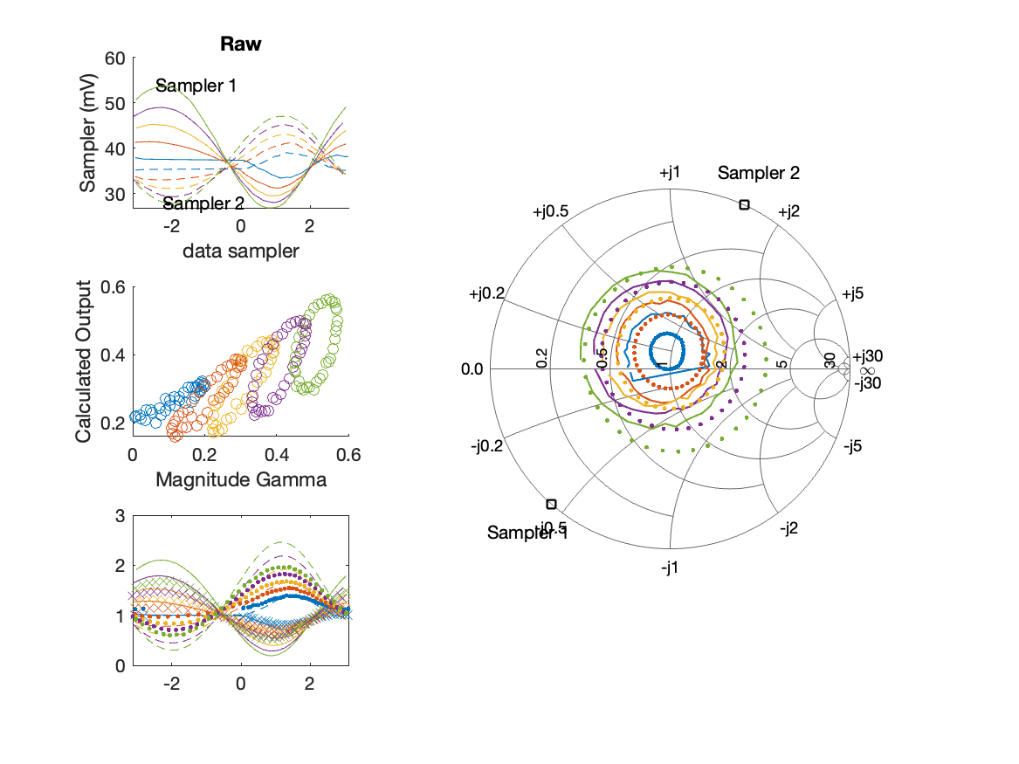
Sampler Performance Frequency 9.90 GHz, Power 16 dBm
Sampler Av
Sampler 1: 21.560
Sampler 2: 35.206
Sampler Offset (rather than -1)
-2.0084
Goodness Of fit
0.67231

Slide 54
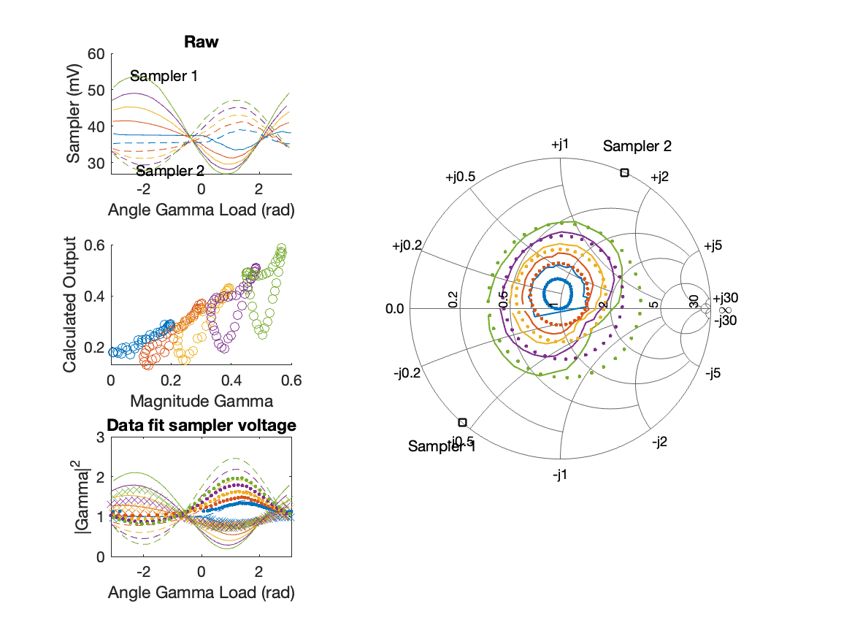
Sampler Performance x^3 Frequency 9.90 GHz, Power 16 dBm
Sampler Av
Sampler 1: 1.458845e+00
Sampler 2: 0.000
Sampler Av3
Sampler 1: 14.870
Sampler 2: 19.016
Sampler Offset (rather than -1)
-0.50194
Goodness Of fit
0.45147

Slide 55
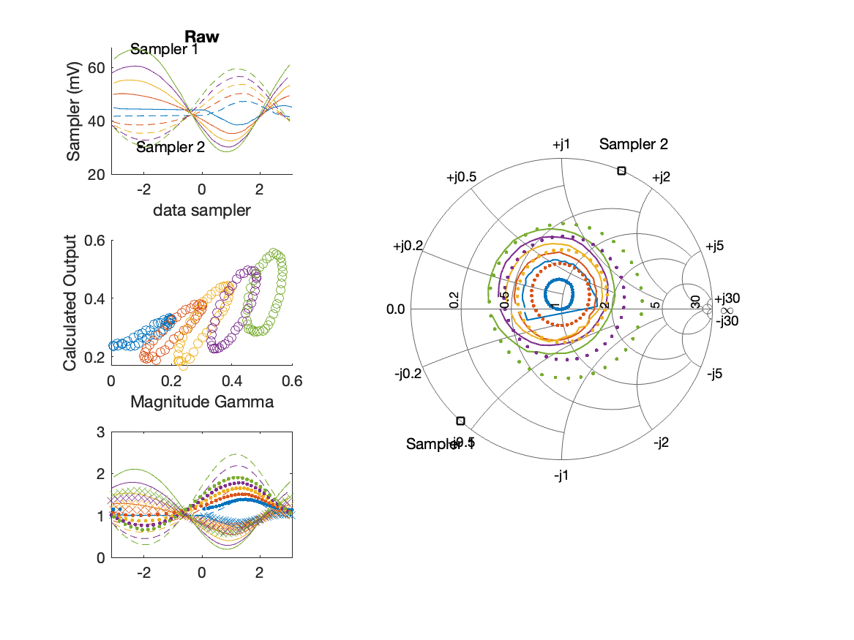
Sampler Performance Frequency 9.90 GHz, Power 18 dBm
Sampler Av
Sampler 1: 13.323
Sampler 2: 21.238
Sampler Offset (rather than -1)
-1.4242
Goodness Of fit
0.79627

Slide 56
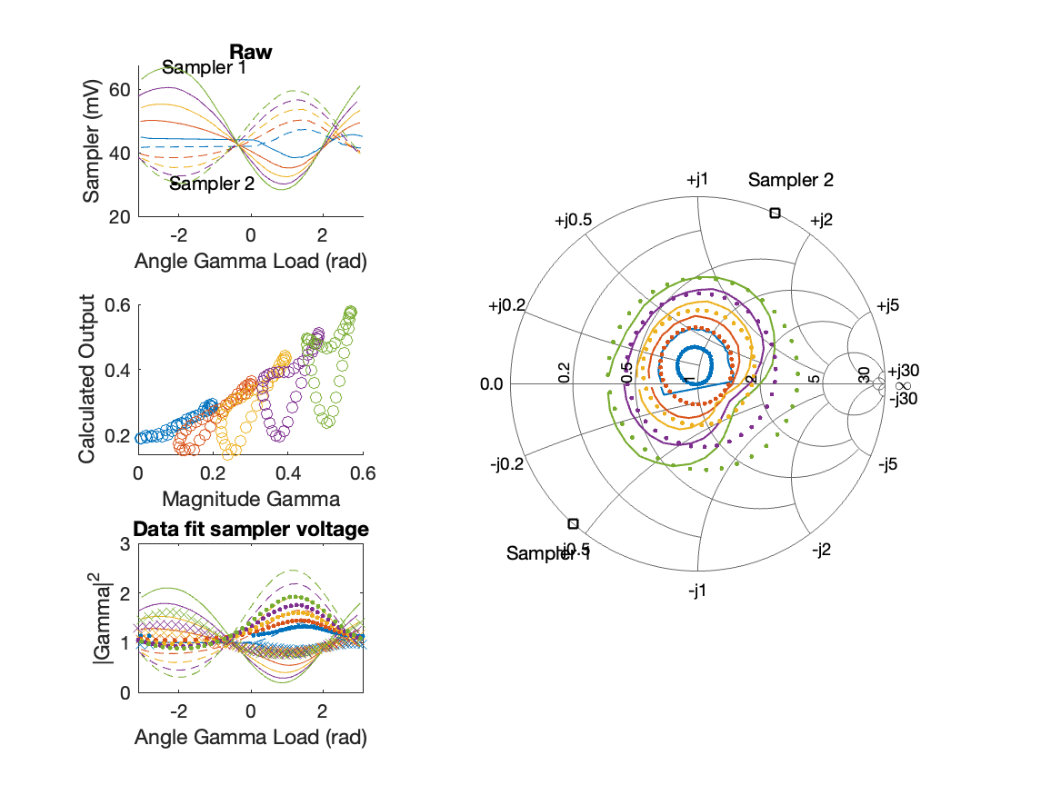
Sampler Performance x^3 Frequency 9.90 GHz, Power 18 dBm
Sampler Av
Sampler 1: 9.335474e-07
Sampler 2: 0.000
Sampler Av3
Sampler 1: 11.565
Sampler 2: 14.154
Sampler Offset (rather than -1)
-0.30775
Goodness Of fit
0.50579

Slide 57
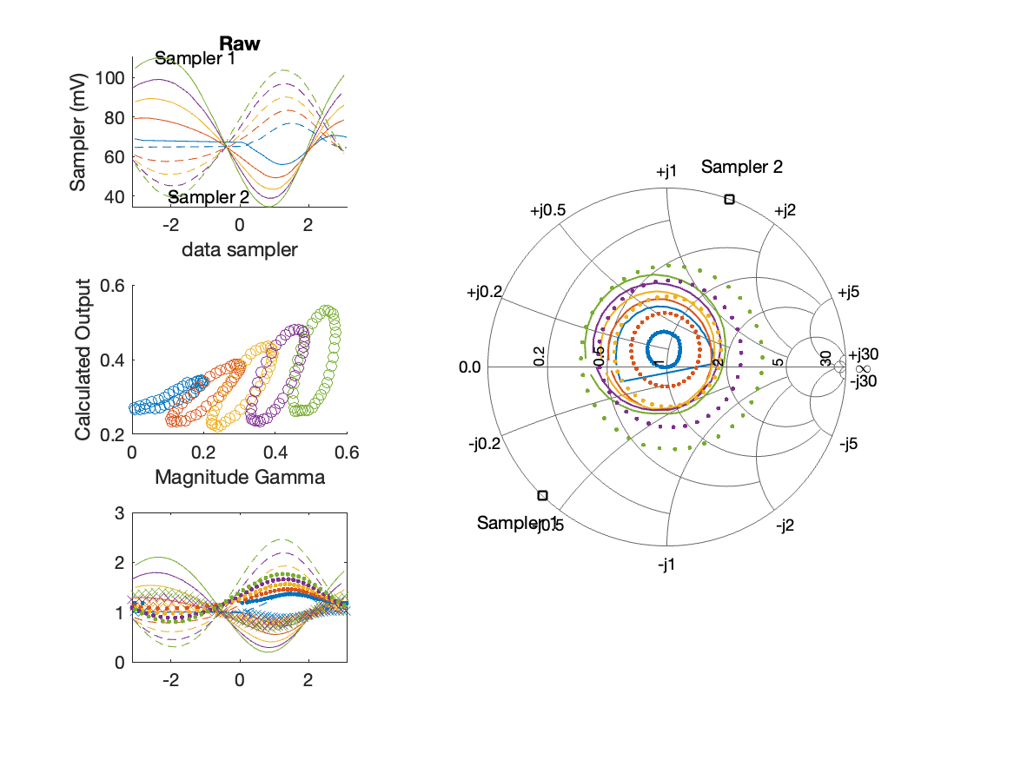
Sampler Performance Frequency 9.90 GHz, Power 22 dBm
Sampler Av
Sampler 1: 4.799
Sampler 2: 7.473
Sampler Offset (rather than -1)
-0.73726
Goodness Of fit
1.0055

Slide 58
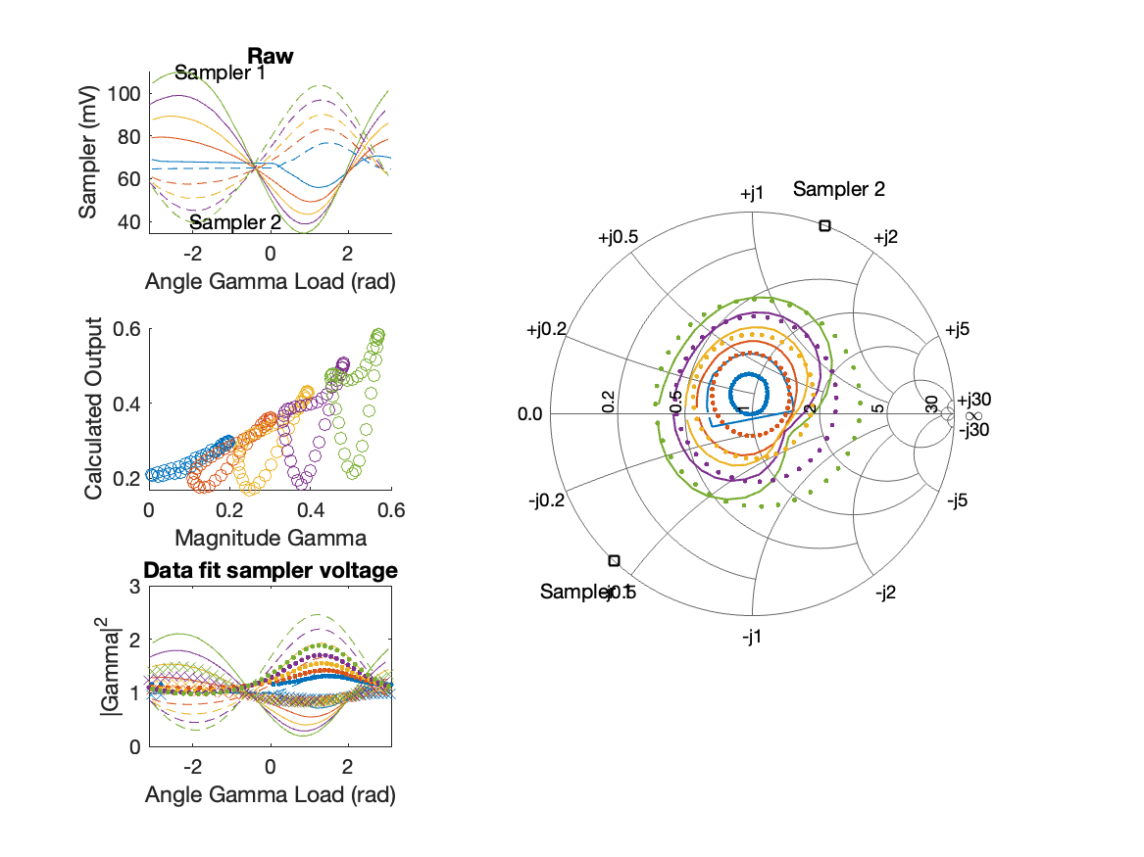
Sampler Performance x^3 Frequency 9.90 GHz, Power 22 dBm
Sampler Av
Sampler 1: 2.823176e-14
Sampler 2: 0.000
Sampler Av3
Sampler 1: 6.406
Sampler 2: 7.541
Sampler Offset (rather than -1)
-0.15558
Goodness Of fit
0.59403

